Slide 1
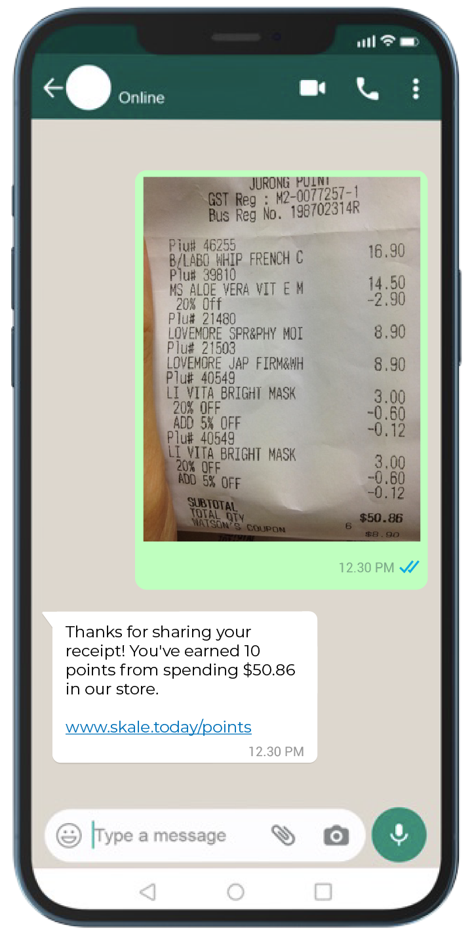
WhatsApp
Chatbot
INTRODUCTION GUIDE

Slide 2
WHAT'S INSIDE
Why Partner with SKALE?
Experience SKALE's WhatsApp Solution
User Journey Experience
Agency Partnership Tiers
Our Agency Onboarding Journey
How to Activate SKALE’s Solutions
Watch our Product Video
WhatsApp Chatbot
Contact Us
1
2
3
4
5
6
7
9
15

Slide 3
Track In-Store Conversions and Demonstrate ROI to Clients
Why Partner with SKALE?
New Revenue Share Opportunity
Resell SKALE’s Technology
(20% - 50% Mark Up on Discounted Pricing)
Tech Fully Managed by SKALE)
Opportunity to Increase Client Budgets and Total Size of Client Accounts
SKALE’s Agency Partners are generating 6-digit revenue (USD) from re-selling SKALE’s Technology Solutions
Go beyond Tactical Campaigns,
Help Clients Capture Customer Data
Free Partnership Program
No Frills, No Minimum Targets
Full Access to Agency Resources
1

Slide 4
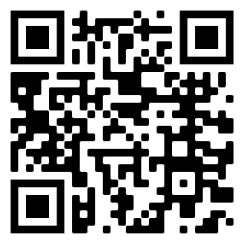
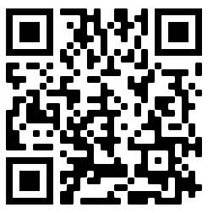
SKALE's WhatsApp Chatbot
What can our chatbot do for you?
Experience SKALE’s WhatsApp Solution
WATCH HOW IT WORKS
Collect personal data and give out promo codes even before your eCommerce shoppers reach your marketplaces.
Automatically verify in-store and online receipts, product barcodes, QR codes, and order IDs.
Enrich customer profiles through engaging activities and mini-games.
Reward customers instantly based on their personal or purchase data
1
2
3
4
2
GrowthDesk

Slide 5
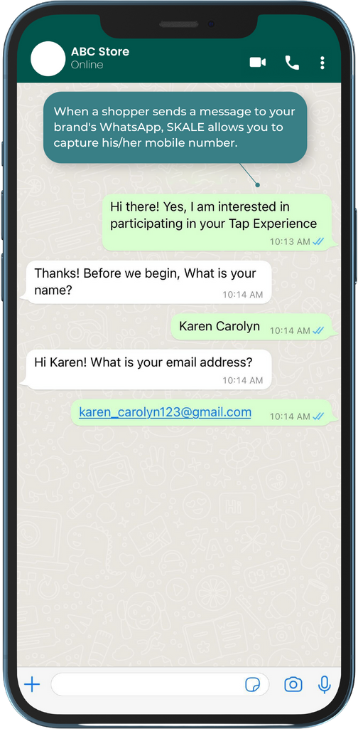
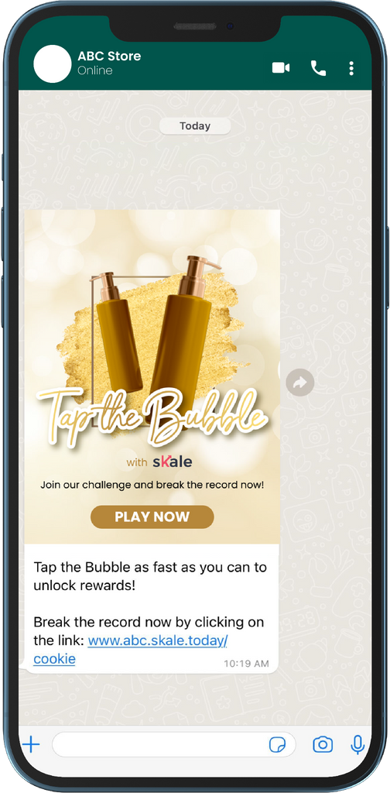
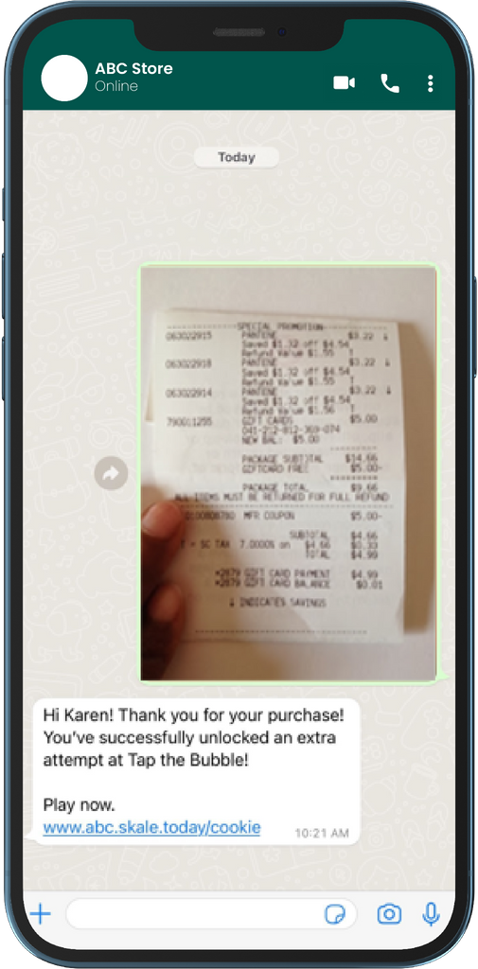
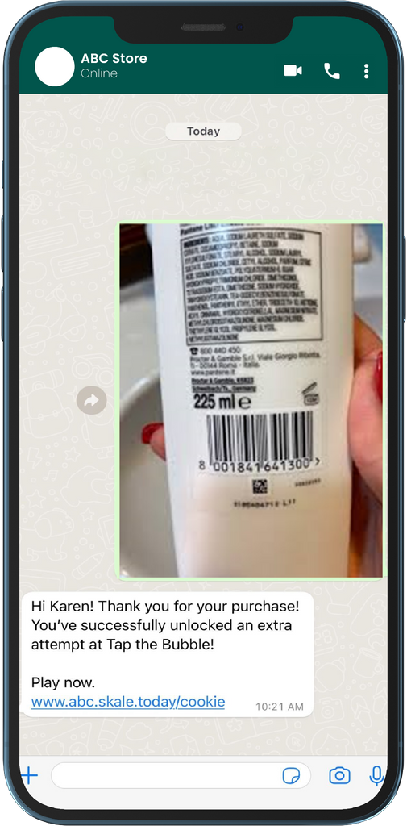
Here’s how our WhatsApp chatbot works
1. Users can submit their personal details via the brand's WhatsApp chatbot.
2. Deliver rewards or unlock gamified experiences for registrants.
3. Verify receipt uploads and deliver personalized rewards
4. FMCG and CPG brands also have the option to validate product barcodes.
3

Slide 6
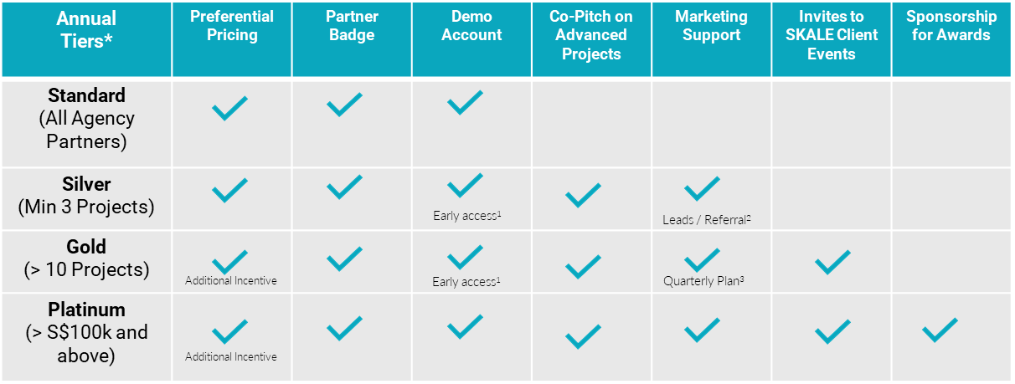
AGENCY PARTNERSHIP TIERS
*Annual tiers reset at end of each calendar year
Early access to new product roll-outs for Standard and Advanced Modules
SKALE reserves full discretion on its marketing and lead generation plans to generate leads for its agency partners
SKALE shall align with its agency partner on its quarterly marketing budget and support
4

Slide 7
OUR AGENCY ONBOARDING JOURNEY
Introduction to SKALE
Signing of Standard Agency Partnership Agreement
Provide Access to
Agency Portal
Demo(s)
Ready to use Slides
Rate Card
Agreement
FAQ
Trainings for
Sales Team / Account Managers / Digital Marketing
C-Suite
Introduction to
Digital Marketers / Account Managers /
(Optional)
Proof-of-Concept
With Agency’s Client
5

Slide 8
HOW TO ACTIVATE SKALE’S SOLUTIONS
Agency Creates
Project via
Dashboard
Agency Requests SKALE Quotation From Partner Manager
& Signs Off
SKALE
Activates Project Created by Agency
Standard
Co-Pitch with Agency
(SKALE as Technology Partner)
SKALE Reviews Requirements from Agency
Does Agency Require Deck from SKALE?
Yes
Advanced
SKALE provides Quotation and Est. Timeline
No
6

Slide 9
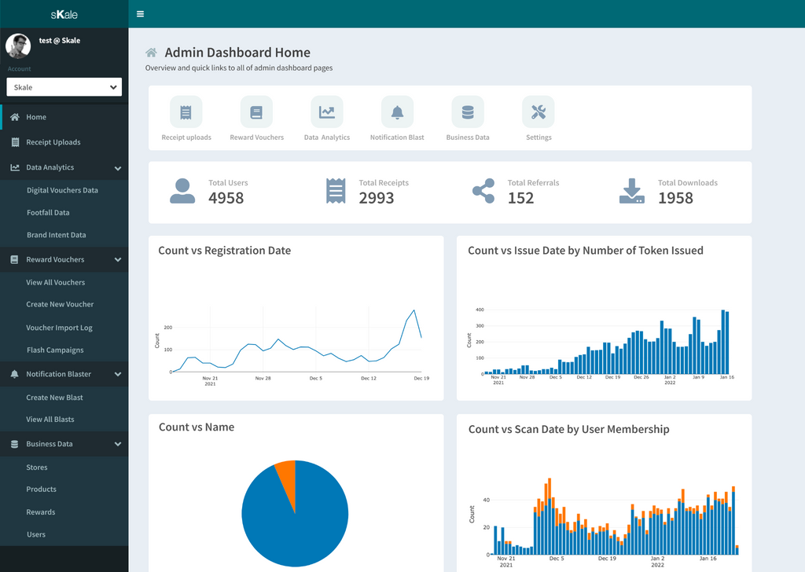
LEARN MORE WITH A SKALE EXPERT
You'll be able to collect, track, and manage real-time customer and purchase data from our WhatsApp chatbot and smart receipts platform from a single dashboard.
We’ll also let you use these data points to send personalized SMS and email campaigns.
WATCH OUR PRODUCT VIDEO
7

Slide 10
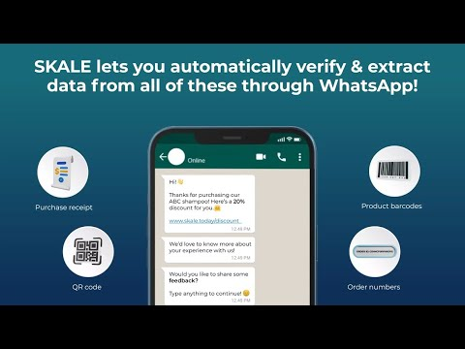
8

Slide 11
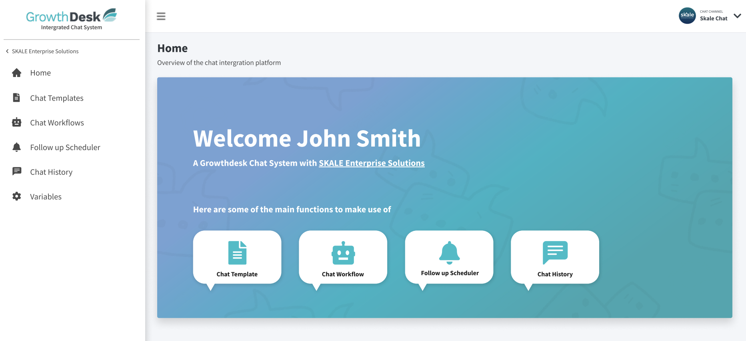
SKALE's WhatsApp Dashboard
9

Slide 12
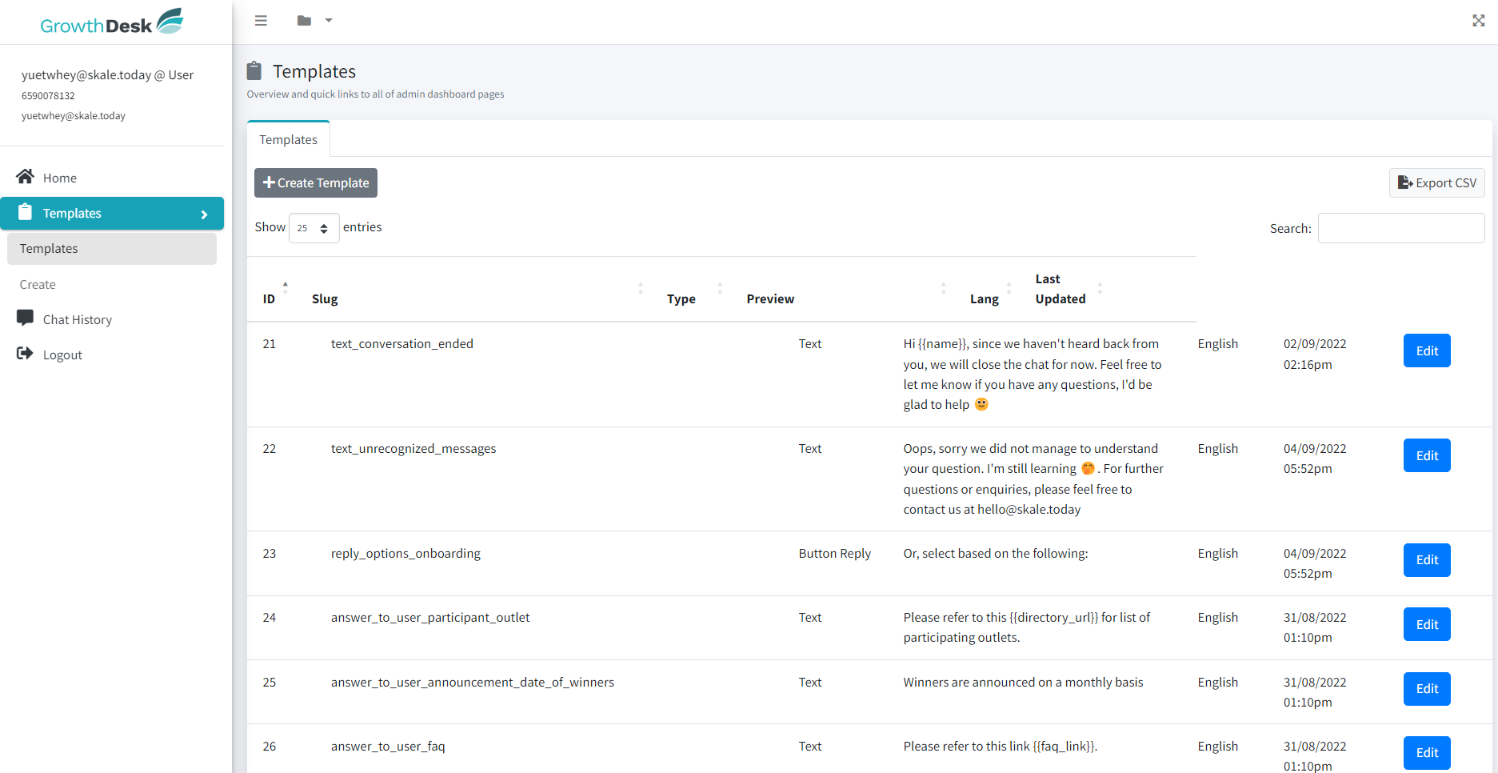
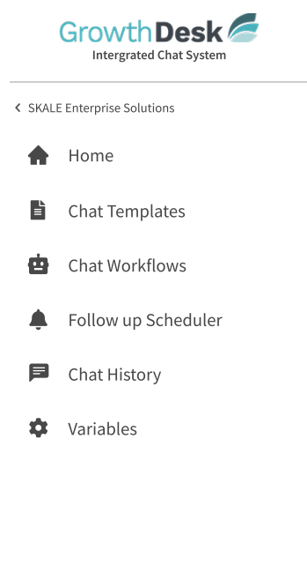
SKALE's WhatsApp Solution
Customize every Whatsapp Workflow from SKALE’s Dashboard
10

Slide 13
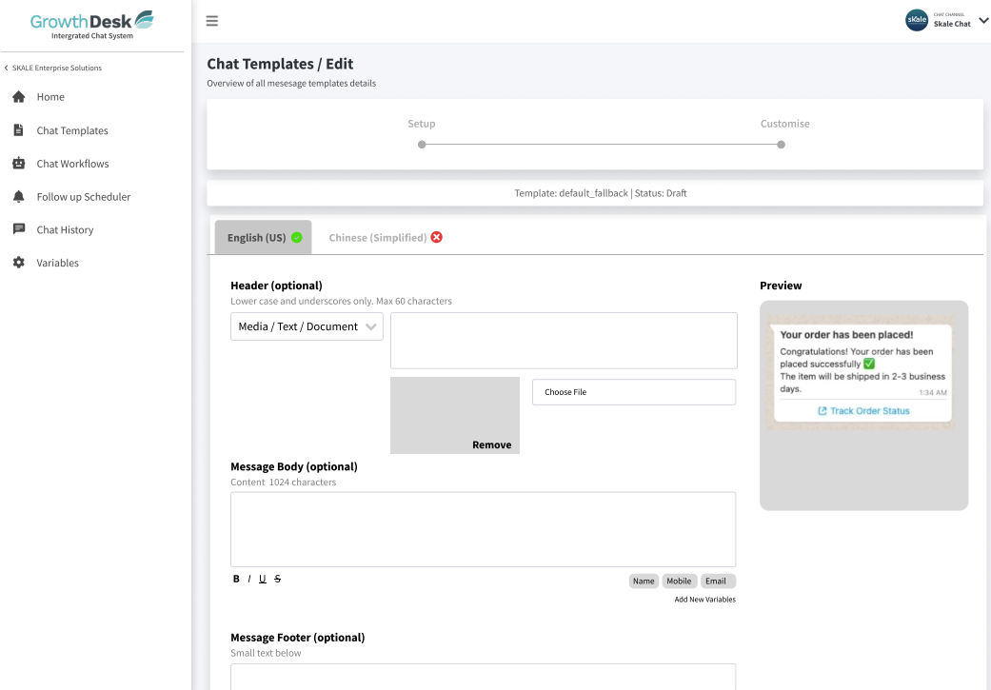
Create WhatsApp Chat Templates Easily
11

Slide 14
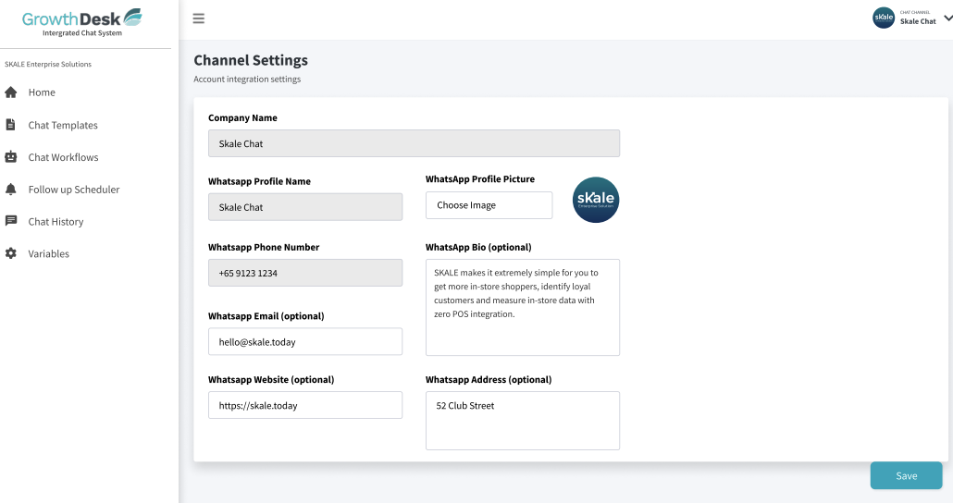
Customize and Manage your WhatsApp Channel
12

Slide 15
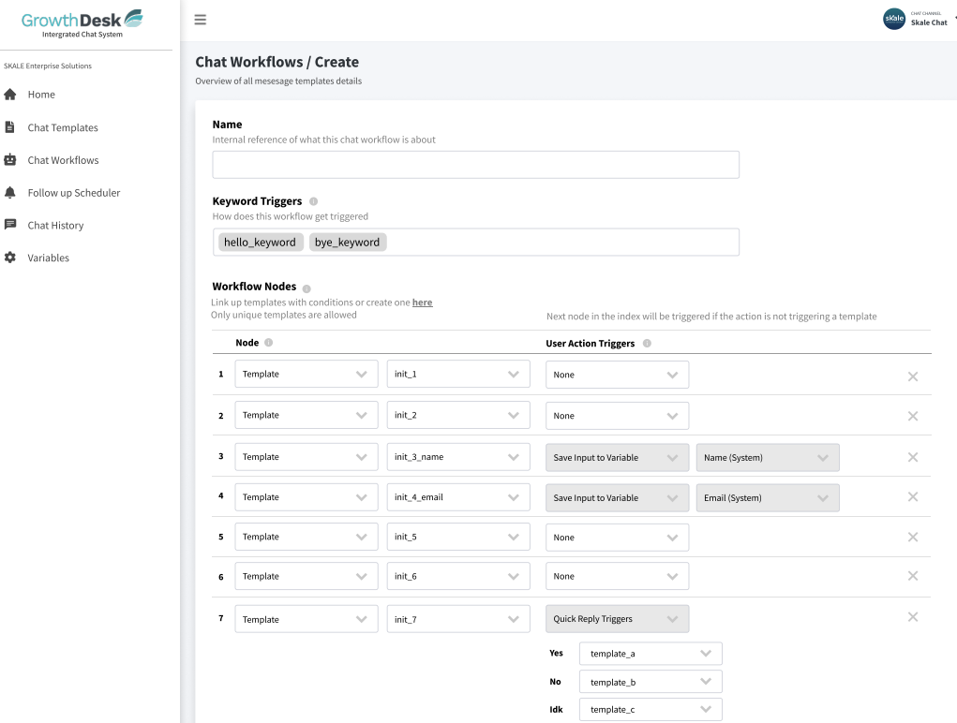
Design Every Workflow Easily
13

Slide 16
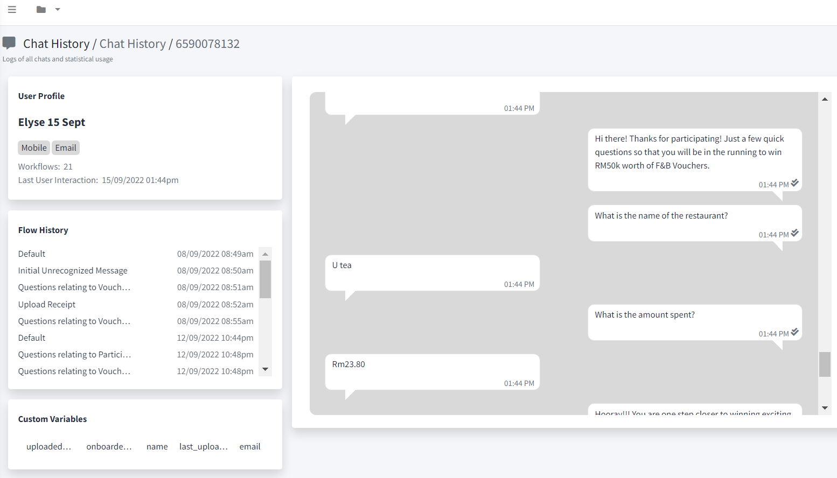
SKALE's WhatsApp Solution
Track every conversation from SKALE’s Dashboard
14

Slide 17
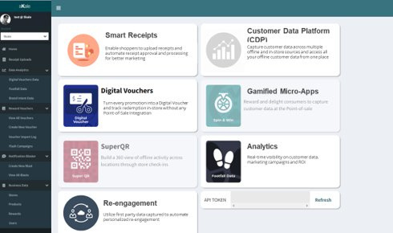
Experience our Marketing Platform today!
BOOK A DEMO
or email us at hello@skale.today

