Slide 1
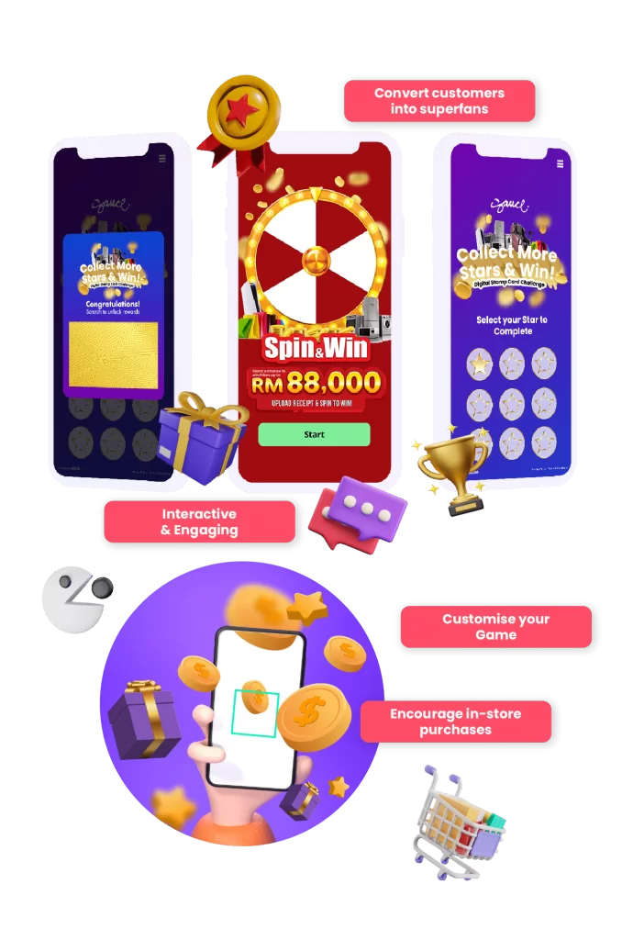
Gamification
Guide
INTRODUCTION GUIDE

Slide 2
WHAT'S INSIDE
Why Partner with SKALE?
SKALE’s Suite of Micro-Apps
Challenges
Standard Package of Games
Spin & Win
Digital Scratch Card
Daily Riddles/Quizzes
Advanced Packages of Games
Digital Stamp Card
Augmented Reality
Metaverse
Gamification FAQs
Contact Us
1
3
6
7
8
12
16
19
20
23
28
36
37

Slide 3
Track In-Store Conversions and Demonstrate ROI to Clients
Why Partner with SKALE?
New Revenue Share Opportunity
Resell SKALE’s Technology
(20% - 50% Mark Up on Discounted Pricing)
Tech Fully Managed by SKALE)
Opportunity to Increase Client Budgets and Total Size of Client Accounts
SKALE’s Agency Partners are generating 6-digit revenue (USD) from re-selling SKALE’s Technology Solutions
Go beyond Tactical Campaigns,
Help Clients Capture Customer Data
Free Partnership Program
No Frills, No Minimum Targets
Full Access to Agency Resources
1

Slide 4
Type of Gamification shall depend on Objective / Goals
Engagement
Social Media Following
App Installs
Footfall and Spend
Virality
SKALE recommends incorporating the following mechanics for every successful gamification:
Multiple micro-engagement
Referral
Longevity to Mechanic
Daily / Weekly New Activity
Attractive Rewards in line with Objectives (E.g. App Promo Code, Ecommerce Promo Code, Vouchers)
SKALE also recommends allowing all engaged audience to participate, and incorporate mechanics to incentivize spending rather than restricting participation to only spending shoppers
Leverage on
Gamification to
Achieve Your
Marketing Objectives
Spot the Difference
2
GrowthDesk
‹#›

Slide 5
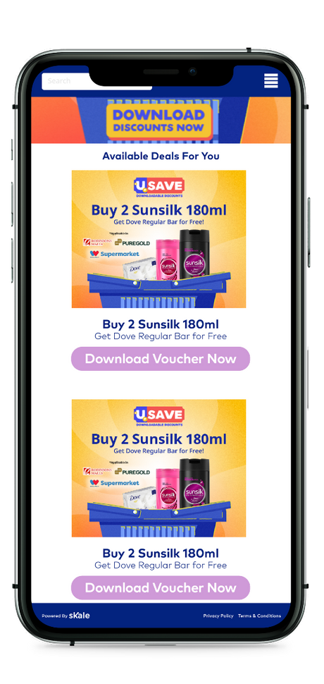
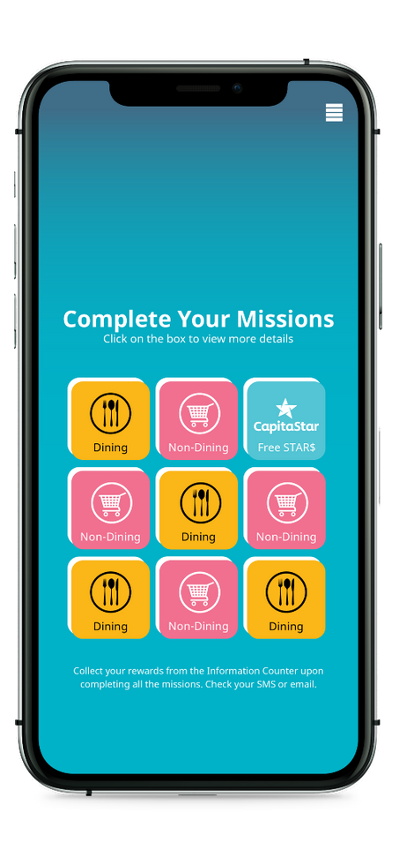
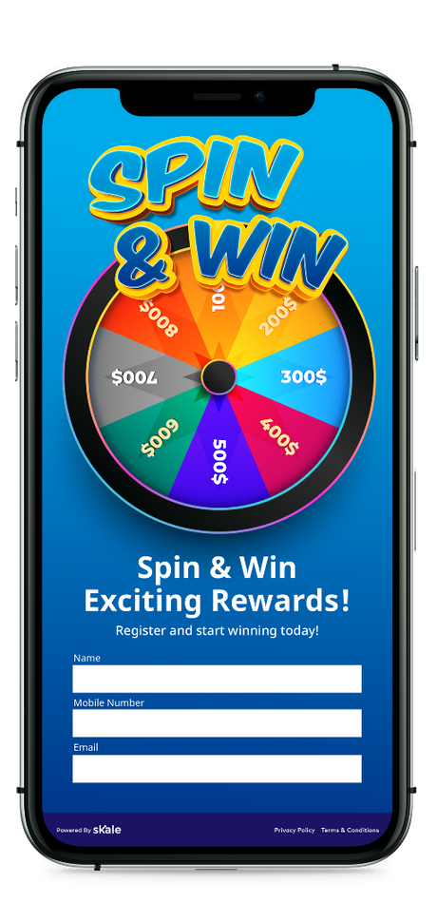
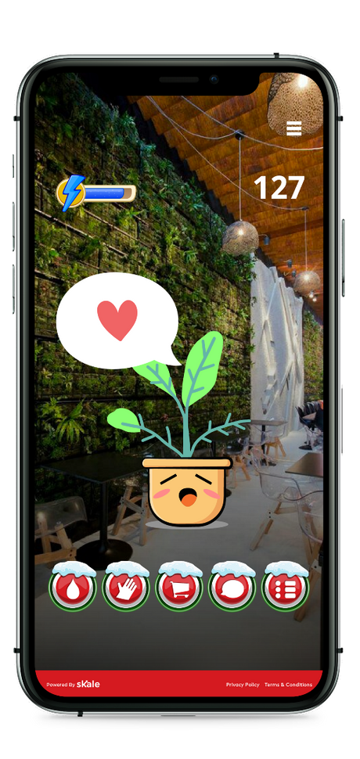
SKALE’s Suite of Micro-Apps
Digital Voucher
Digital Stamp Card
Spin and Win
Augmented Reality
3
GrowthDesk
‹#›

Slide 6
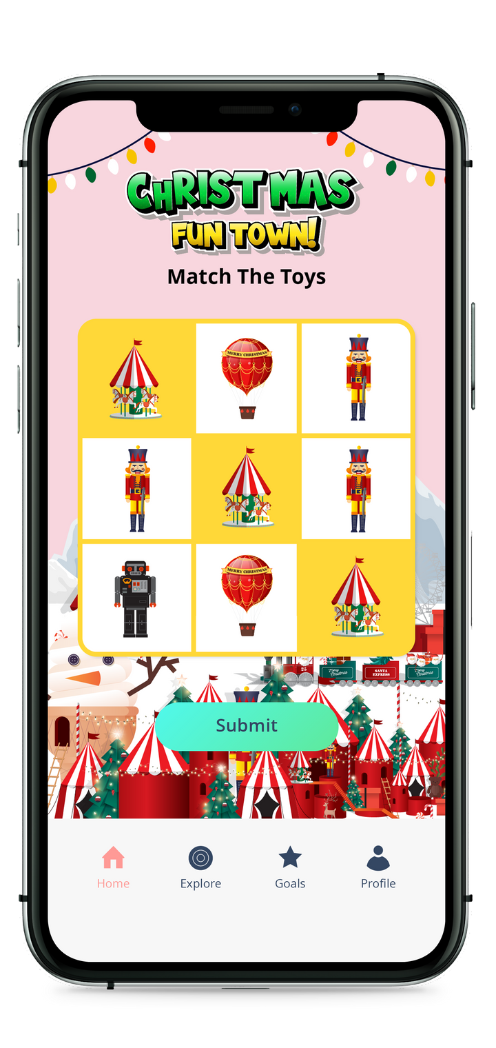
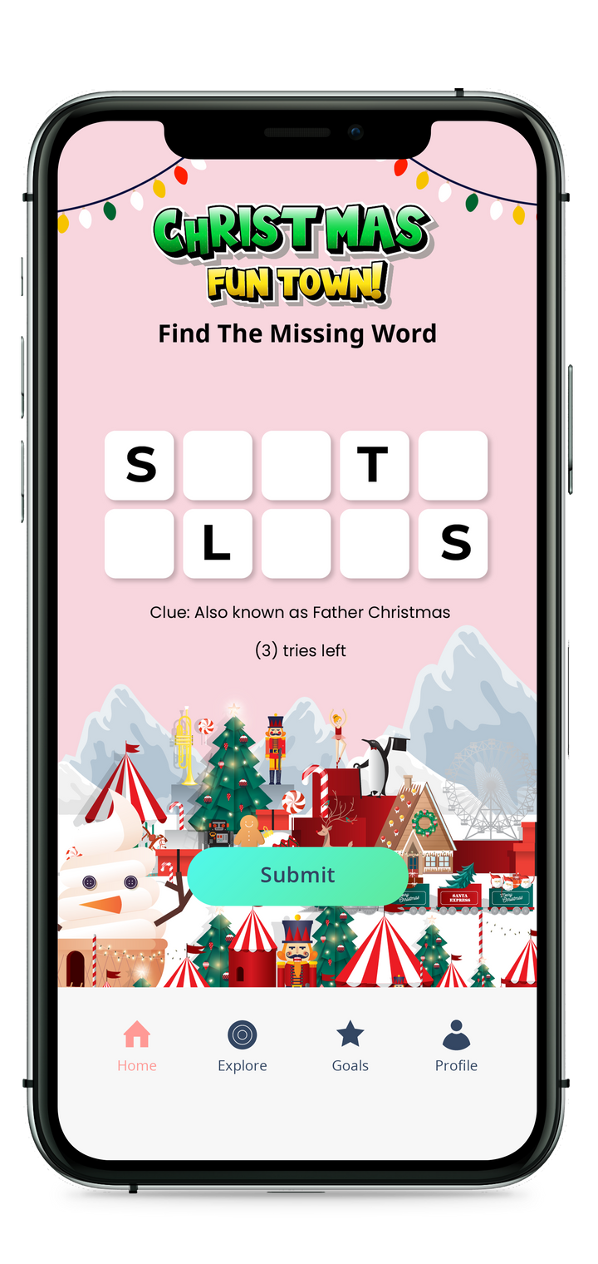
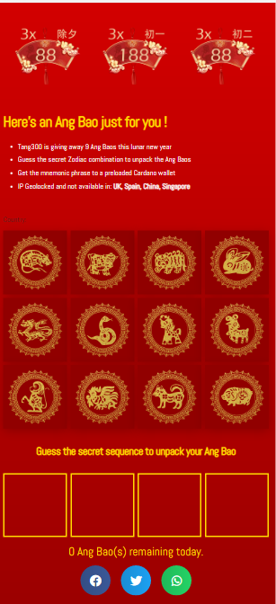
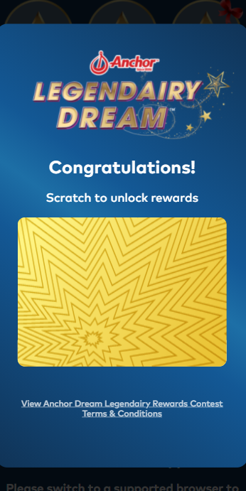
SKALE’s Suite of Mini Games
Match the Tiles
Or Find the Lucky Combination
Daily Word Buzz Challenge
Daily Scratch Card
4

Slide 7
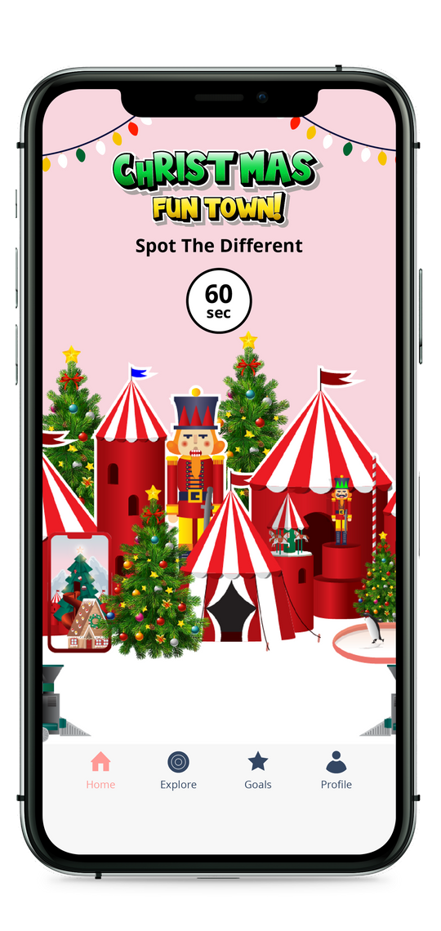
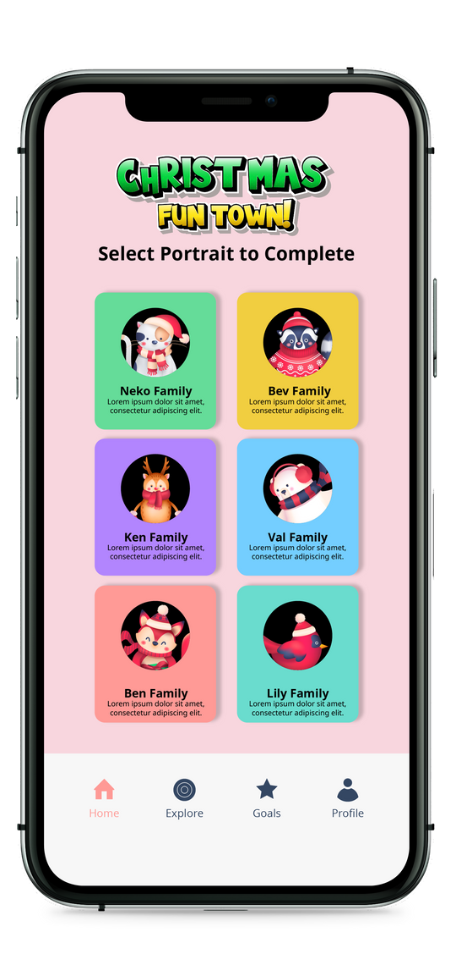
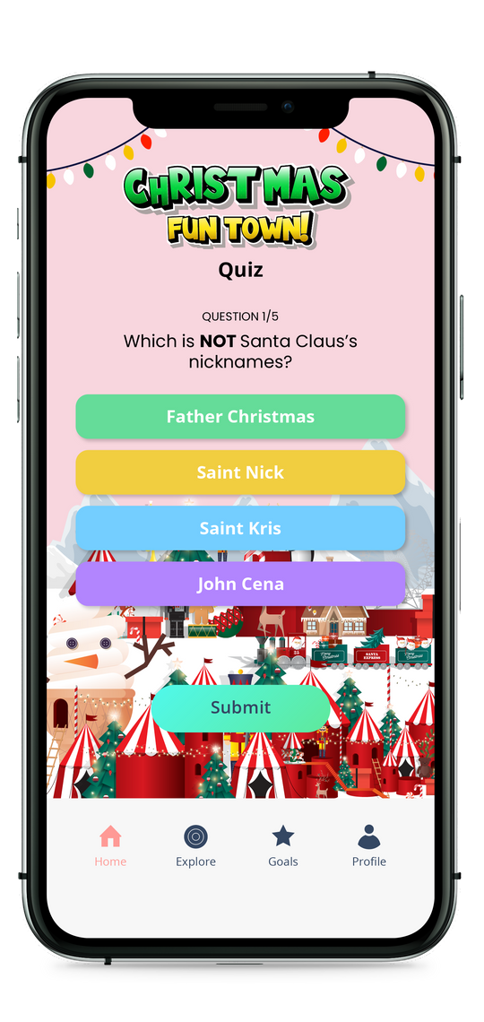
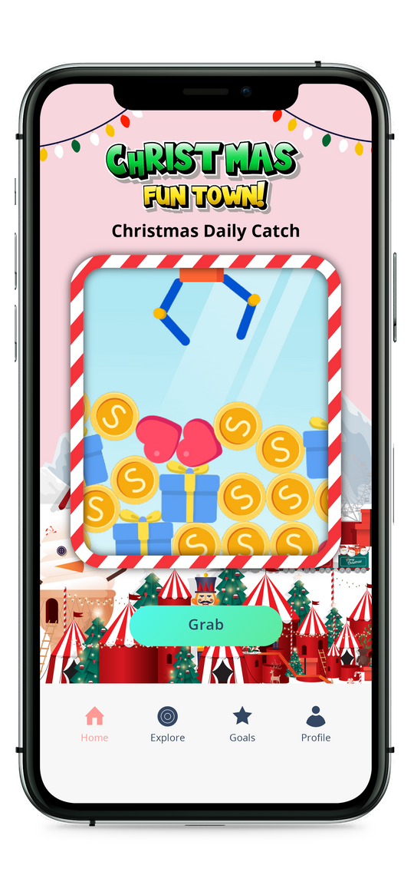
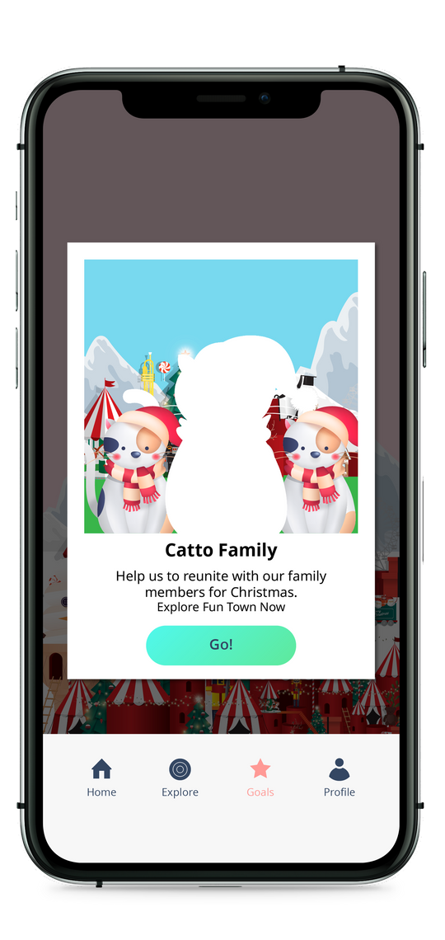
SKALE’s Suite of Mini Games
Spot the Difference
Scan Product QR Codes
Daily Quiz
Claw Machine
5

Slide 8
CHALLENGES
Upload a Receipt
Follow a social media page
Upload a photo
You can either manually approve customer receipts on the platform or utilize SKALE's smart receipts platform to automatically verify receipt uploads. Rewards can be personalized based on receipt data.
After users follow your Instagram or Facebook pages, you can request that they upload a screenshot of your page as proof that they completed the challenge.
You can ask users to upload a photo of your product, a selfie from your event, or any other image that demonstrates they've completed the platform challenge you've set.
Scan a QR code
Install an app
Log In
QR codes can be generated by our platform for your stores, product packaging, or offline activations.
SKALE's games automatically scan QR codes and award points or chances to players in real-time.
You can start the game as soon as users open the app. Alternatively, you can ask them to upload a screenshot of the app on their phones before awarding points or chances.
If you've enabled the daily check-in, you'll be able to award points or chances each time a user logs in or launches the game.
6

Slide 9
Standard Package of Games
Spin & Win, Digital Scratch Card, and Digital Quiz
GrowthDesk
‹#›

Slide 10
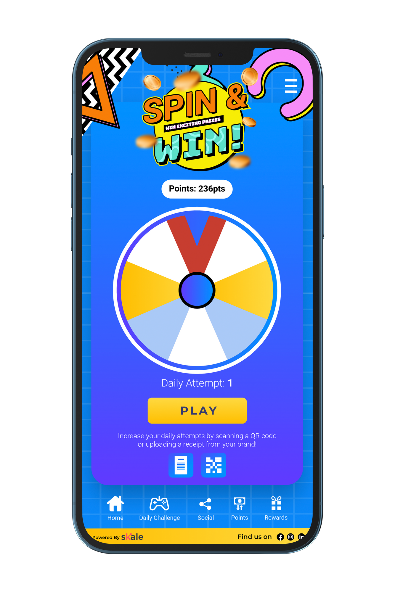
Spin & Win
Spin & Win is an excellent tool for engaging and rewarding your customers online or in-store, whether it's a daily gamified pop-up or an incentive for every purchase.
Increase opt-ins and convert customers into superfans by giving them the opportunity to win multiple prizes.
Our drag-and-drop editor allows you to quickly create branded and engaging Spin & Win platforms. Without POS integration, you can assign rewards, track customer behavior, and calculate in-store ROI from your campaign.
8

Slide 11
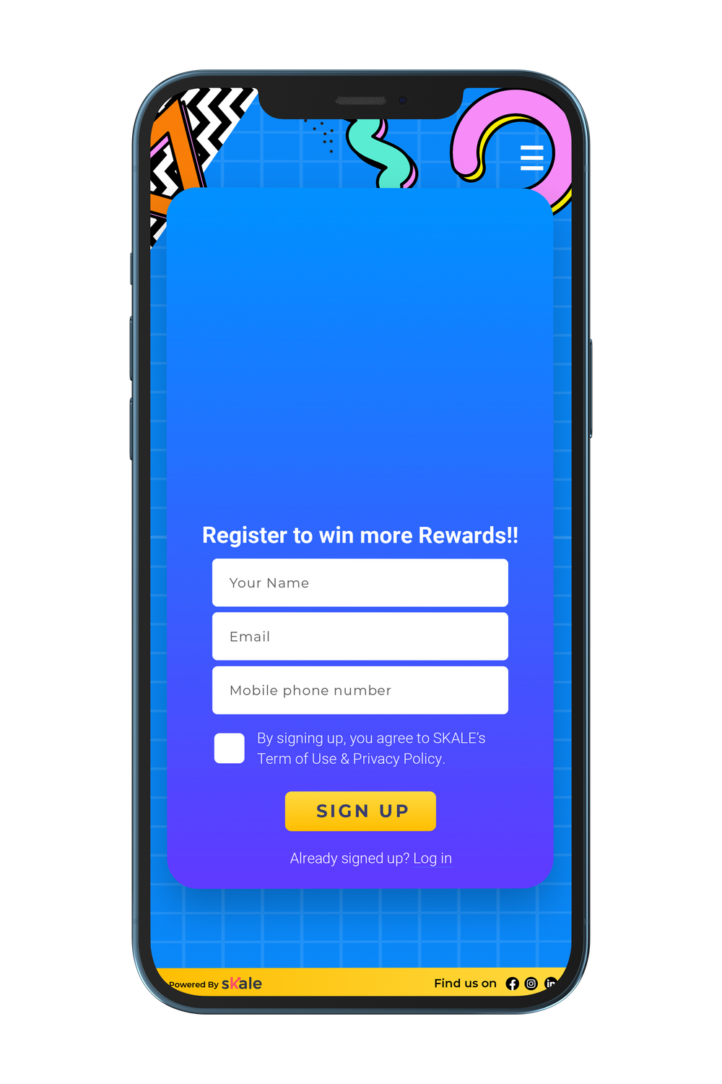
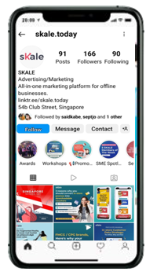
USER JOURNEY – SPIN & WIN
Shoppers are driven to the platform via Social Media Ads, EDM, or to the organic follower base
Capture First Party Customer Data
When Shoppers register
Shopper is directed to Spin and Win gamification module
9

Slide 12
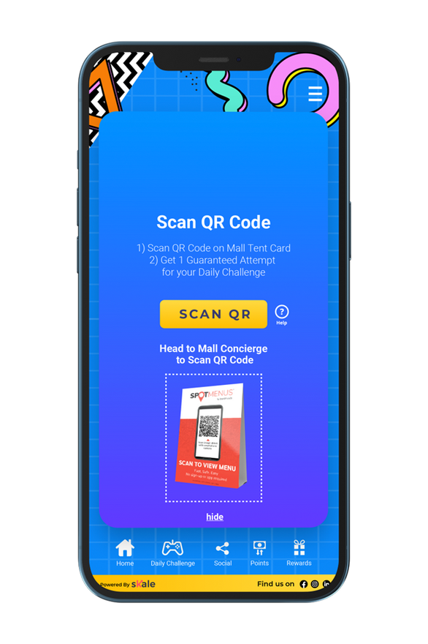
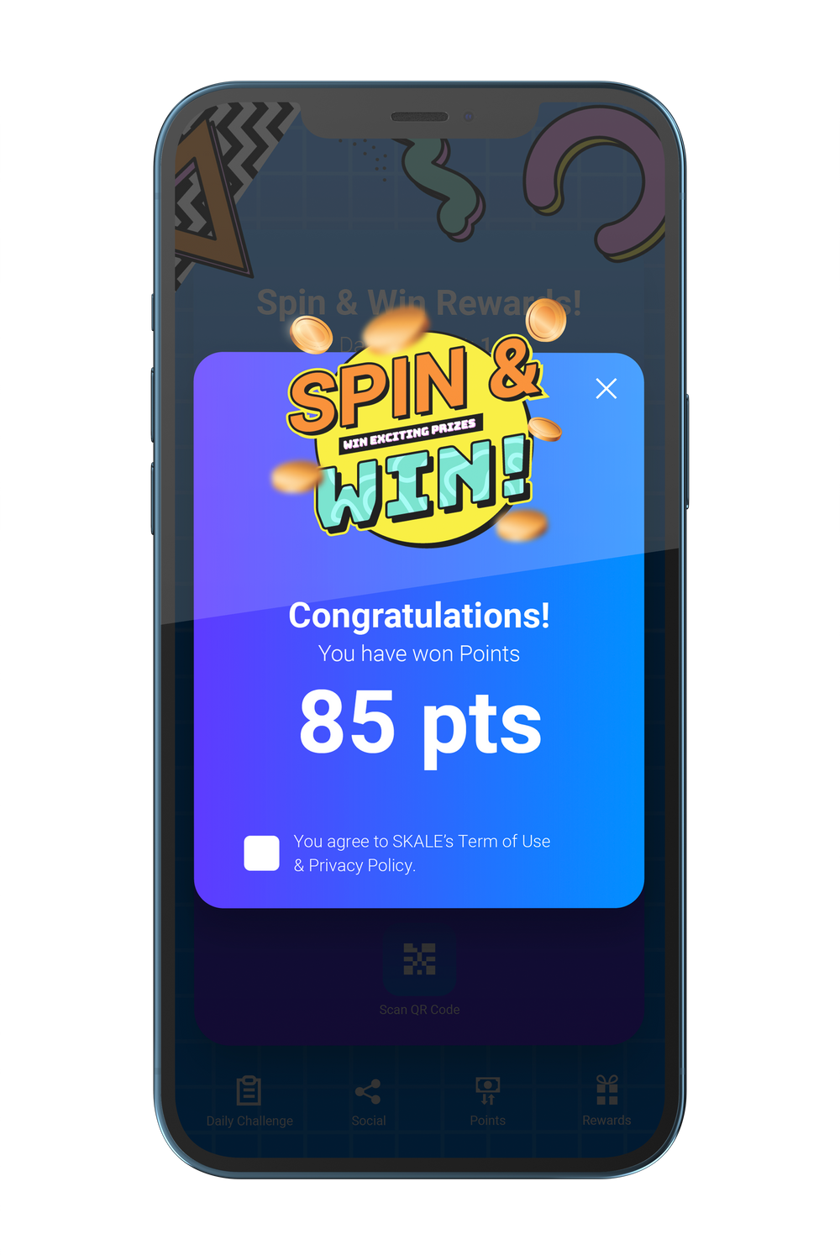
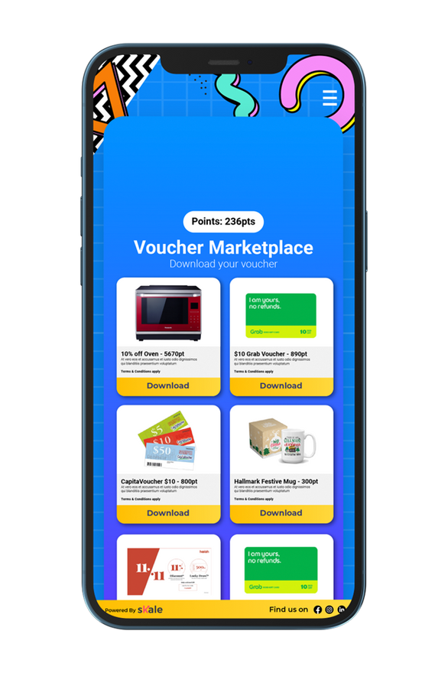
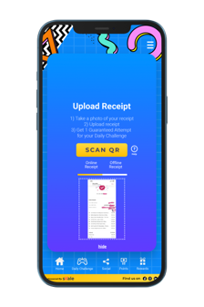
USER JOURNEY – SPIN & WIN
Upload Receipt
The user allowed one attempt daily to scratch upon Registering (to allow for Instant Gratification and Engagement)
User prompted Scan QR or upload receipt upon making a purchase to unlock additional points
SKALE has the ability to customize Point provisioning/number of attempts provisioned based on actions taken
Scan QR
Refer Friend
Follow Social Media
Upload photo
Shopper can redeem their rewards through the rewards marketplace
Digital Vouchers (in-store)
eCommerce Promo Code
Physical Gifts or more
10

Slide 13
HOW TO CREATE A SPIN & WIN​
SPIN & WIN FAQS
Can I add more wheel slices in the game? | No. Currently, you can use up to six wheel slices.
Can I set the number of winners for each day? | No. The game's system is randomized.
What are the formats I can upload on each wheel slice? | You can put either an image or a text to show the message or the prize.
Can automatic check in be enabled? | Yes, this will give the user instant free points. You can determine the number of points they will win upon check in.
11

Slide 14
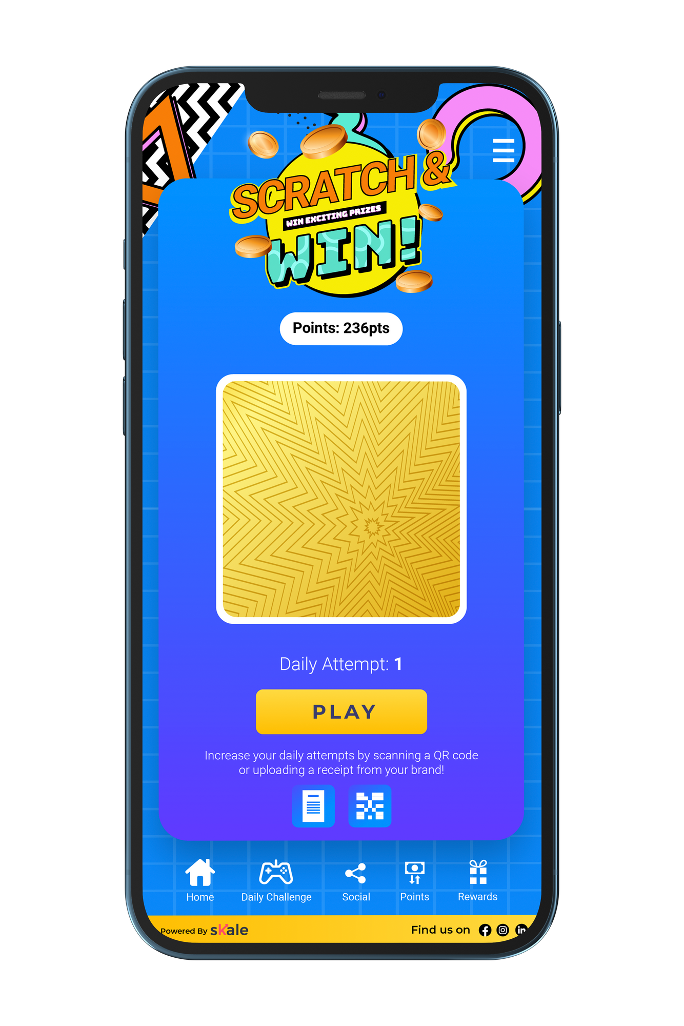
Digital
Scratch
Card
Reward Shoppers dynamically when they complete the actions that matter to you. For example:
Upload Receipt
Scan QR Code In-Store
Refer a Friend
Engage with brand
Customize how you reward the shoppers based on the type of action or the customer lifetime value
12

Slide 15
USER JOURNEY – DIGITAL SCRATCH CARD
Shoppers are driven to the platform via Social Media Ads, EDM, or to the organic follower base
Capture First Party Customer Data
When Shoppers register
Shopper is directed to a Digital Scratch Card platform
13

Slide 16
USER JOURNEY – DIGITAL SCRATCH CARD
Upload Receipt
The user allowed one attempt daily to scratch
upon Registering (to allow for Instant Gratification and Engagement)
User prompted Scan QR or upload receipt upon making a purchase to unlock additional points
SKALE has the ability to customize Point provisioning/number of attempts provisioned based on actions taken
Scan QR
Refer Friend
Follow Social Media
Upload photo
Shopper can redeem their rewards through the rewards marketplace
14

Slide 17
HOW TO CREATE A DIGITAL SCRATCH CARD​
DIGITAL SCRATCH CARD FAQS
Can I award items rather than points? | No. You can only reward points in the Digital Scratch Card game. However, you can include an image of the reward in the winning message so the user knows what item he or she can redeem with the points won.
Can I upload videos or images on the scratch card? | No. You can only display an image and text.
Can I set the number of winners for each day? | No. The game's system is randomized.
Can I change the font of the text? | No. You can only change the text color.
15

Slide 18
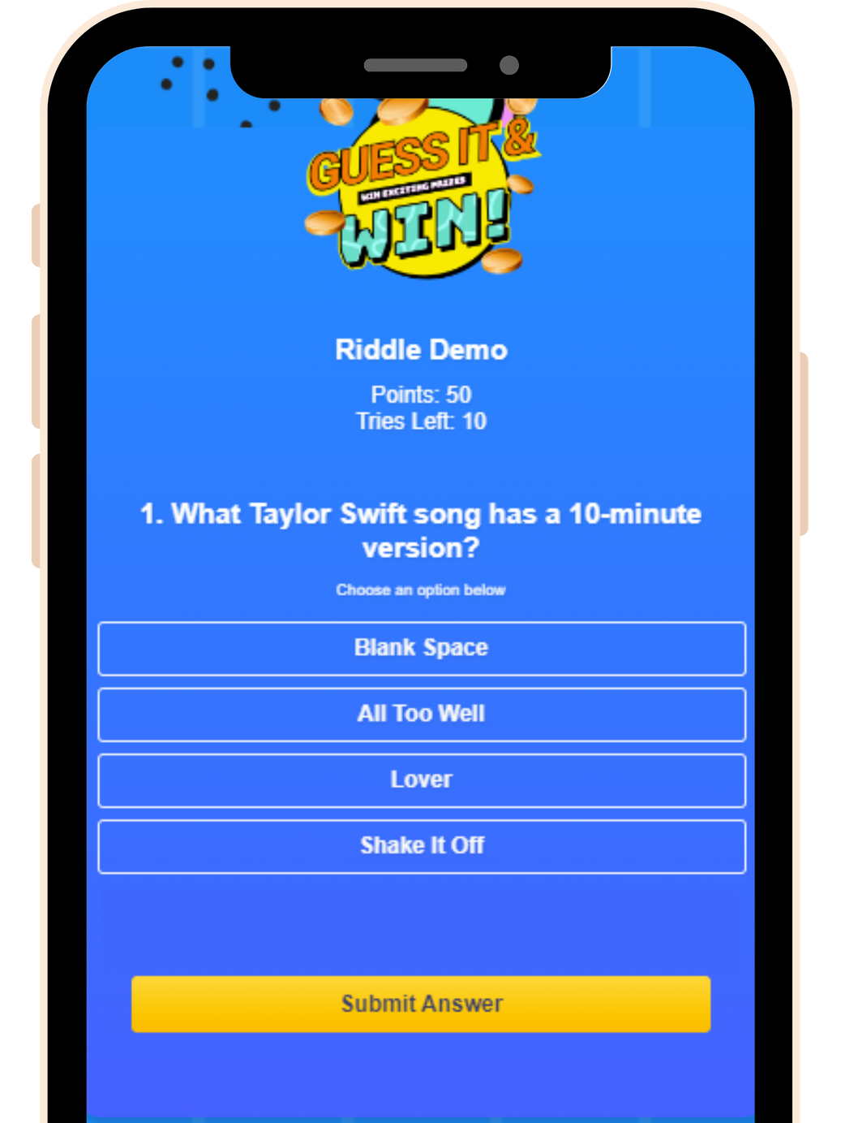
Daily Riddles/ Quizzes
16

Slide 19
USER JOURNEY – DAILY RIDDLE
Shoppers are driven to the platform via Social Media Ads, EDM, or to the organic follower base
Capture First Party Customer Data
When Shoppers register
Shopper is directed to Daily Riddle gamification module
17

Slide 20
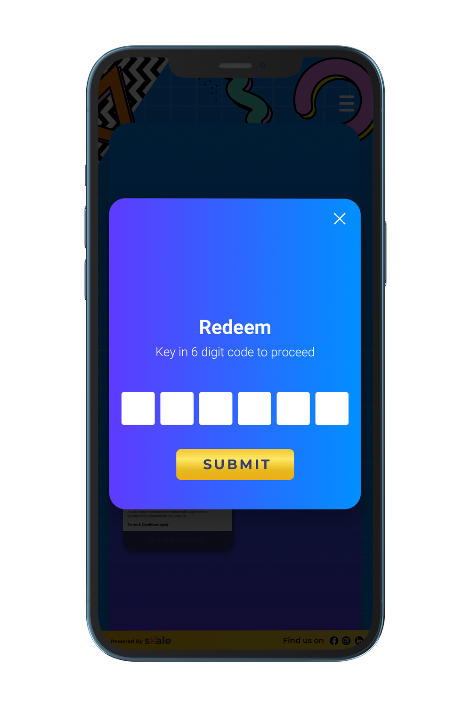
USER JOURNEY – DAILY RIDDLE
Shopper is rewarded with
Points for each attempt.
Upload Receipt
User prompted Scan QR or upload receipt upon making a purchase to unlock additional points
SKALE has ability to customize Point provisioning / number of attempts provisioned based on actions taken
Scan QR
Refer Friend
Follow Social Media
Upload photo
Shopper can redeem their rewards through the rewards marketplace
18

Slide 21
HOW TO CREATE A DAILY RIDDLE
DIGITAL QUIZ/ DAILY RIDDLES FAQS
Is there a limit to the number of questions I can ask? | None.
Do I always need to set an order of questions? | No. You can randomize the order of questions across all your users.
Is there a limit to the number of answers I can provide for each question? | Yes. You can create 2-5 options for each question.
Are there any other quiz types besides multiple choice? | No. Currently, SKALE's riddles only support the multiple-choice format.
Can I use formats other than text in the options? | No.
19

Slide 22
Advanced Package of Games
Standard package games plus Digital Stamp Card, Augmented Reality, Metaverse and Customized Gamification
GrowthDesk
‹#›

Slide 23
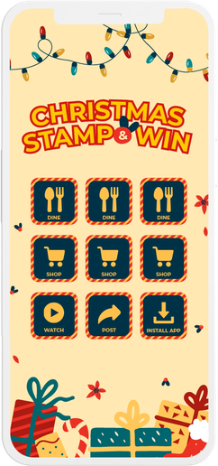
Digital Stamp Cards
Digital stamp cards, like their physical counterparts, can be an effective tool for driving repeat purchases and customer loyalty.
Every time a customer uploads a receipt or completes a desired action, he or she can earn a virtual stamp that can be redeemed for exciting prizes.
Our platform enables you to collect first-party data, provide a stamp for every in-store purchase, and deliver personalized incentives.
You can customize the design, set stamp conditions, and select from a variety of reward programs, including point-based, discount-based, and direct rewards.
20

Slide 24
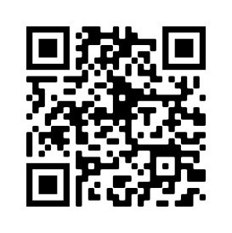
Benefits of Digital Stamp Card Apps Over Physical Stamp Cards
Experience SKALE’s Digital Stamp Card Demo
1
Customers are no longer required to carry physical cards. They also do not need a new one if they misplace their stamp card.
Customers can access it by going to the stamp card platform or scanning a QR code.
Businesses no longer need to worry about running out of stamps or cards to distribute.
There will be no costs associated with printing stamps and cards before the campaign's launch.
Instead of having an employee manually stamp the card, the user can claim it virtually in real-time.
START DEMO NOW
2
3
4
5
21
GrowthDesk

Slide 25
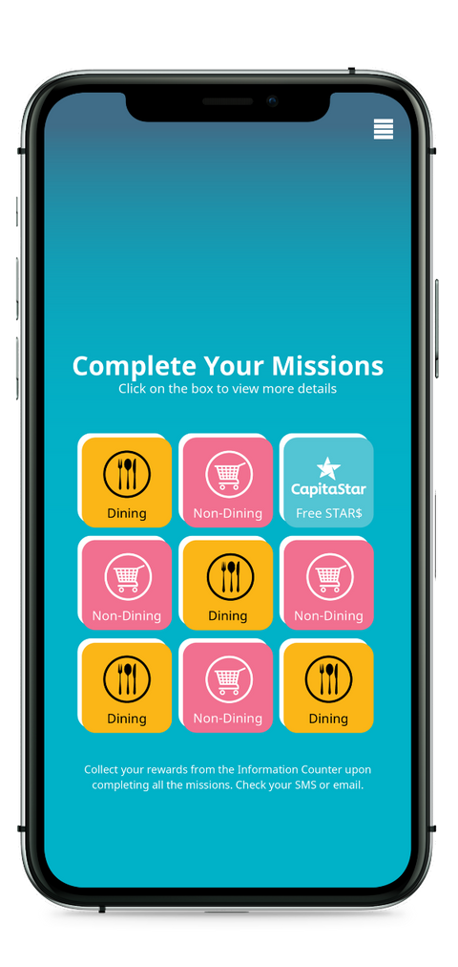
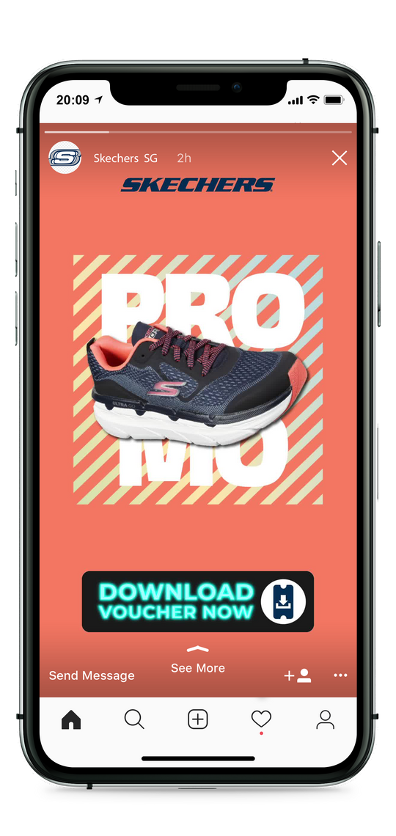
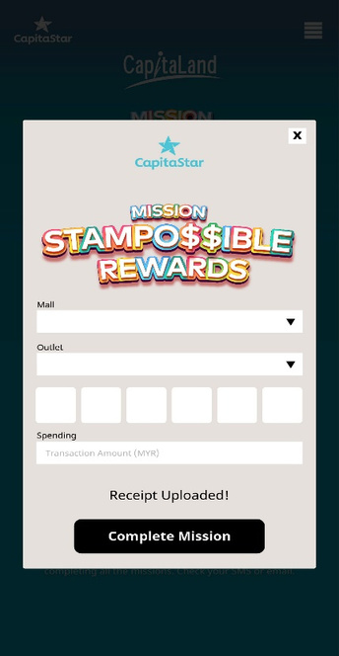
SKALE Collaborates with the Largest Mall Group in Malaysia & Asia to Drive Fully Trackable Tenant Sales with Zero Integration During COVID
SKALE’s Collaboration with CapitaLand:
Leverage on Geo-Fencing Multi-Channel Ads to Drive Most Actionable Shoppers to any of its 7 Shopping Malls across Malaysia
Capture First Party Customer Data (Email, Mobile, Shopper Preference) with Every Participation in SKALE’s Gamified Stamp Card
Real Time Tracking of Tenant Sales Conversion with Unique Pincodes
Automated Segmentation of Customer Data to Uplift Shopper Loyalty, Basket Size Increase and Sales
CAPITASTAR MSR: Thanks for visiting Queensbay Mall today! Here are 3 other store promotions we think you will enjoy and see you next time.
https://capitastar.com.my/digitalvoucher/dskja
22
GrowthDesk
‹#›
5

Slide 26
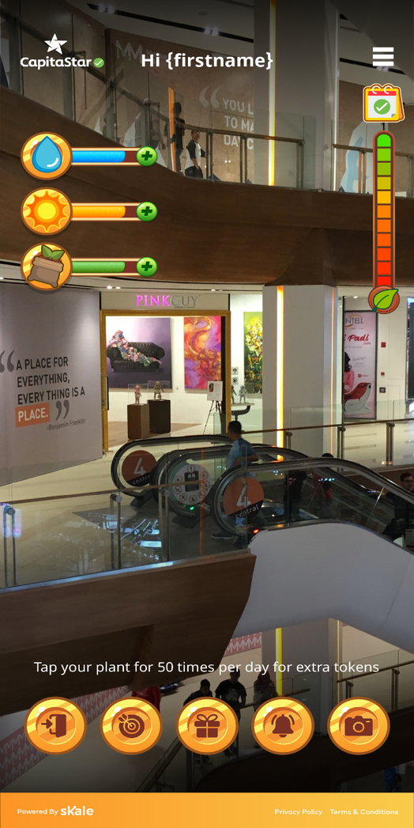
Augmented
Reality
23

Slide 27
Introducing SKALE’s Augmented Reality Campaign
Experience Augmented Reality
Use your mobile phone to click the link below and scan the image to meet SKALE's adorable AR pet.
1
Engage Shoppers at Home, before they Visit Mall
Make Mall Campaigns Measurable, Real-Time Tracking of ROI
Drive App Installs through Gamification
Fully Integrated with App
Automated Re-engagement to Drive App Installs
ACCESS AR DEMO
2
3
4
5
24
GrowthDesk

Slide 28
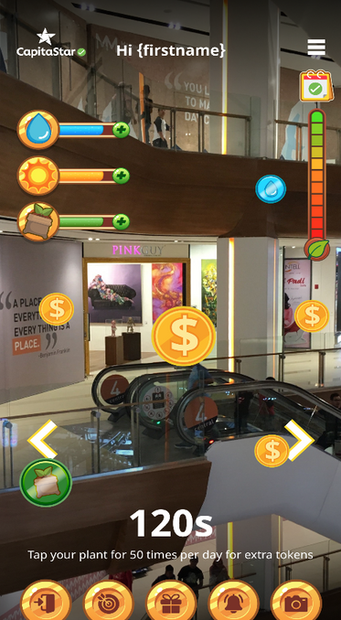
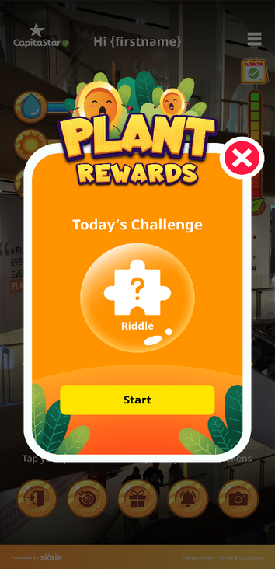
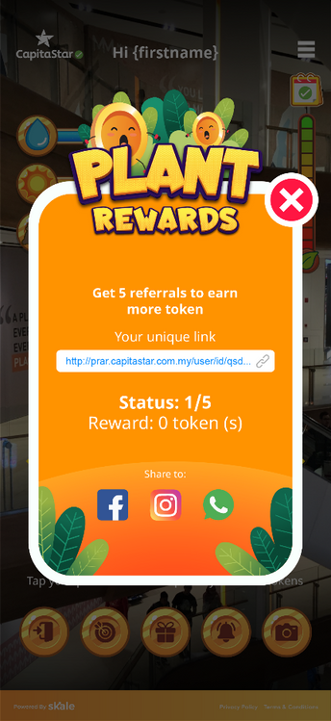
Augmented Reality Gamification, Proven to Drive Shopper Engagement and Action
1
Engage Daily to
Grow AR Plant
2
Daily AR Token Game
3
Unique Daily
Experiences
4
Referral
5 Tokens
Include #plantrewards when posting in social media to stand a chance to win lucky draw cash prize worth up to RM 5000
Upload a Receipt to fully grow plant
Shoppers are provisioned a Seed; Goal is to grow a Plant to reap rewards.
Capture as many tokens in 120s
See twice as many tokens in Mall
Reward Shoppers for Engaging Daily
Refer a Friend; Get Rewarded
with Points for Successful Referral
25

Slide 29
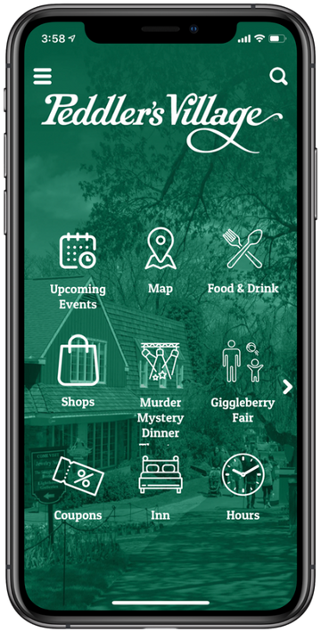
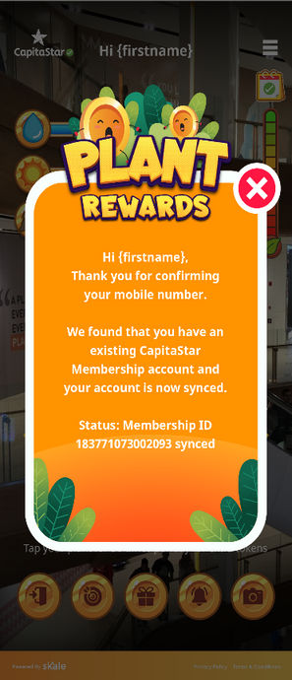
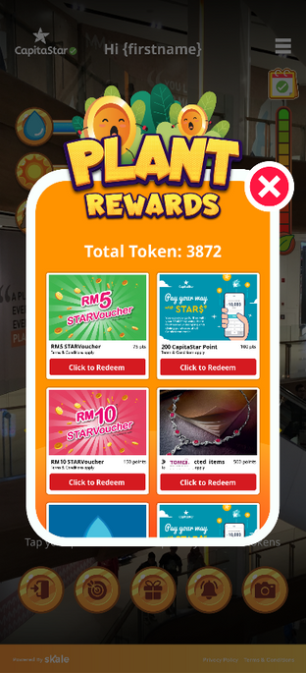
Seamless Integration and User Experience In-App
1
Capture Email, Mobile during Registration
All Gamification
can be made accessible via App
Automated Syncing of Accounts
Incentivizes
App Installs
2
3
4
Engage Daily to
Grow AR Plant
26
GrowthDesk
‹#›

Slide 30
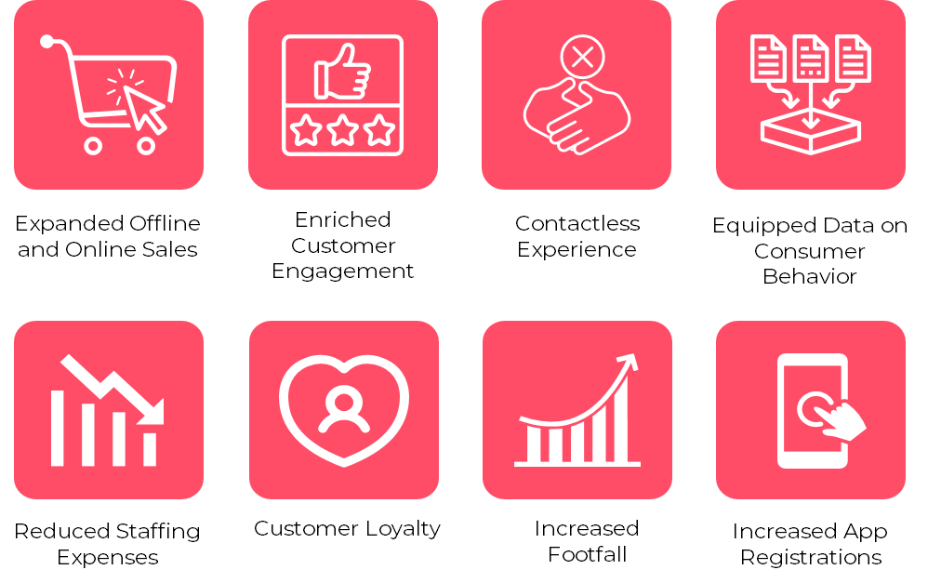
BENEFITS OF AUGMENTED REALITY
27

Slide 31
SKALE'S METAVERSE MALL
28

Slide 32
Campaign Ideas
Introducing SKALE’s Metaverse Campaigns
Create an immersive experience
Digital avatars for everyone
Inside SKALE's Metaverse Mall, you can create a space where friends and families can shop, play, and socialize all at the same time.
Create your own currencies
Offer virtual goods or rewards
Launch digital vouchers that people can redeem offline
Direct people to external channels such as your social media pages
Track every action in a single dashboard
SKALE can simulate physical spaces and offer an immersive experience that goes beyond real-world limitations.
In a 3D space, we can let users create and customize their own avatars.
Deliver an omnichannel experience
Strengthen brand partnerships
Translate rich immersive experiences into incentives that direct shoppers to offline sales channels.
Give your clients something they can't refuse: a more immersive and effective form of advertising.
Track conversions
Connect Metaverse experiences to the SKALE platform to track your customers' online and offline actions.
29
GrowthDesk

Slide 33
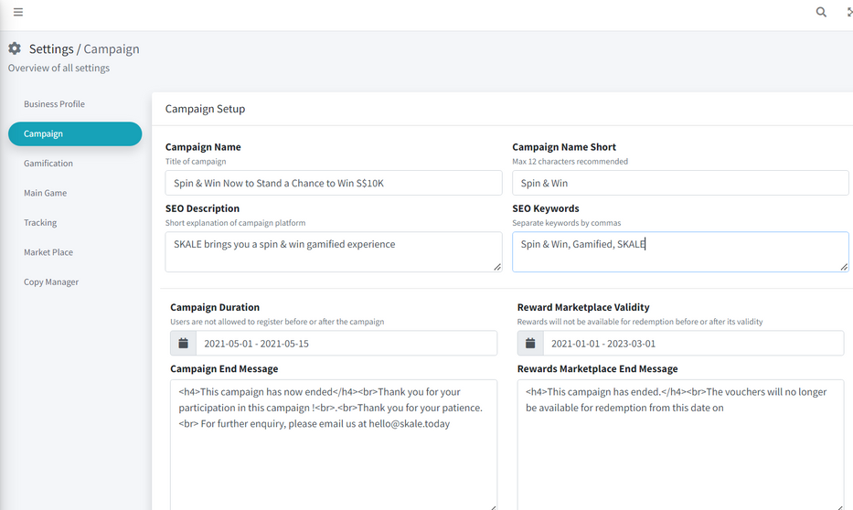
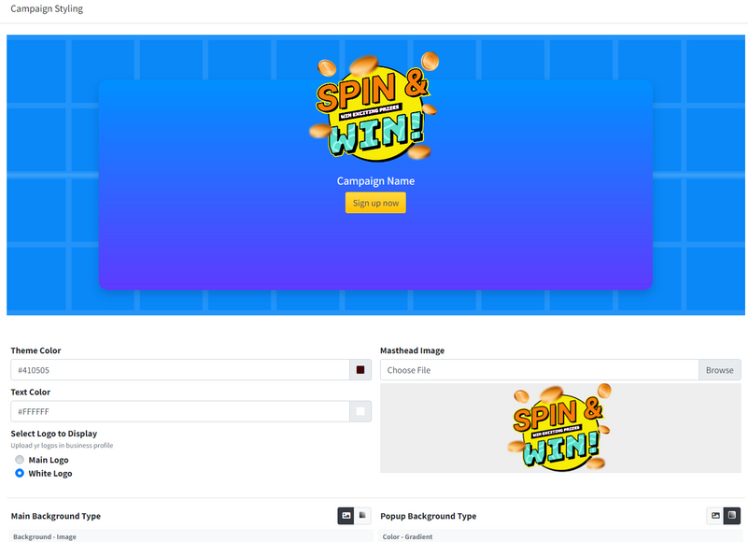
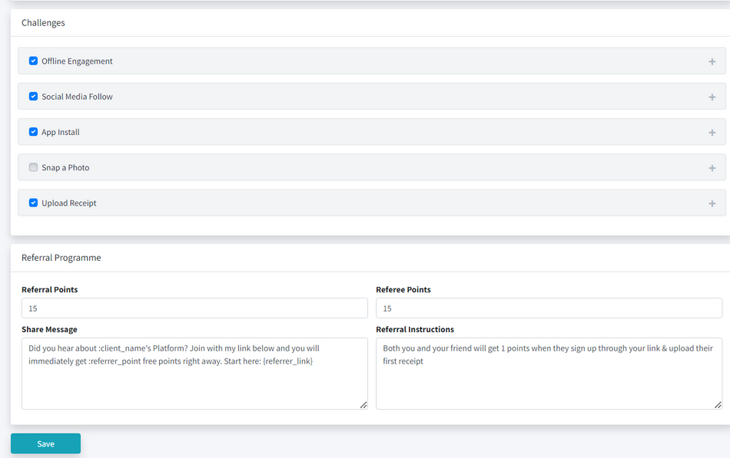
Fully Customizable Gamification System Managed by SKALE or your Agency
1
Customize Campaign Details and Duration
2
Fully Customizable Look and Feel
30
3
Incentivize Shoppers to Achieve Your Objectives

Slide 34
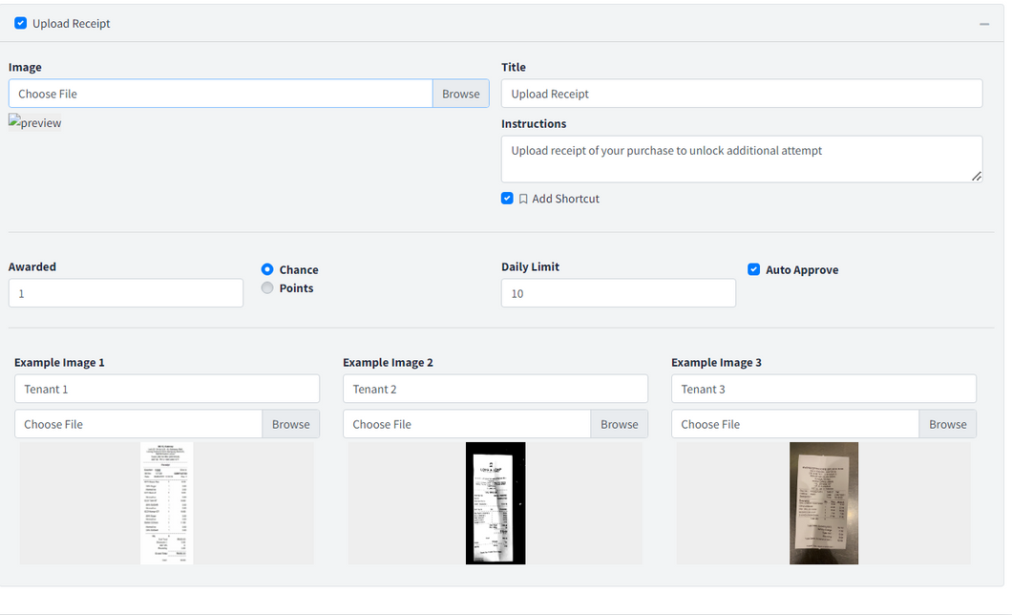
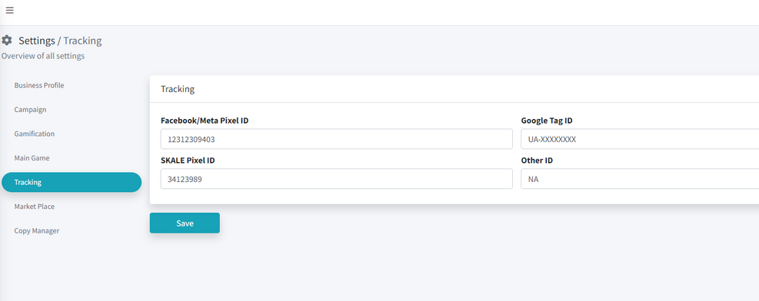
Fully Customizable Gamification System
Managed by SKALE or your Agency
4
Customize Every Single Mechanic within the Game
5
Embed Your Marketing Trackers
31

Slide 35
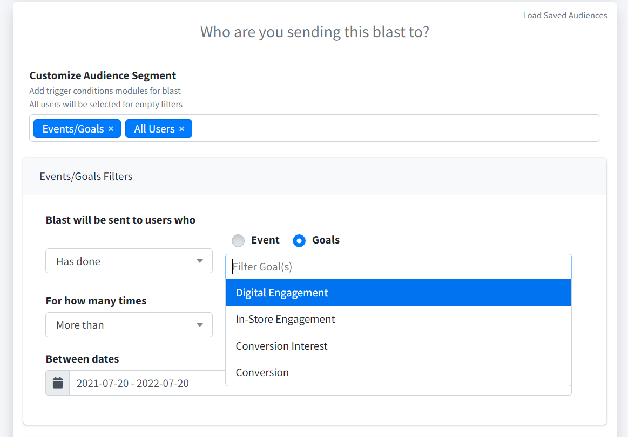
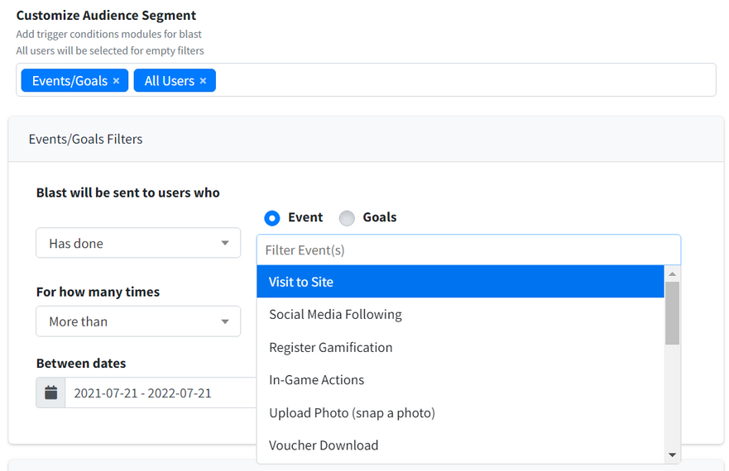
Segment all your Offline Customer Data
Easily segment all your users based on their offline behaviour and trigger targeted re-engagement
32

Slide 36
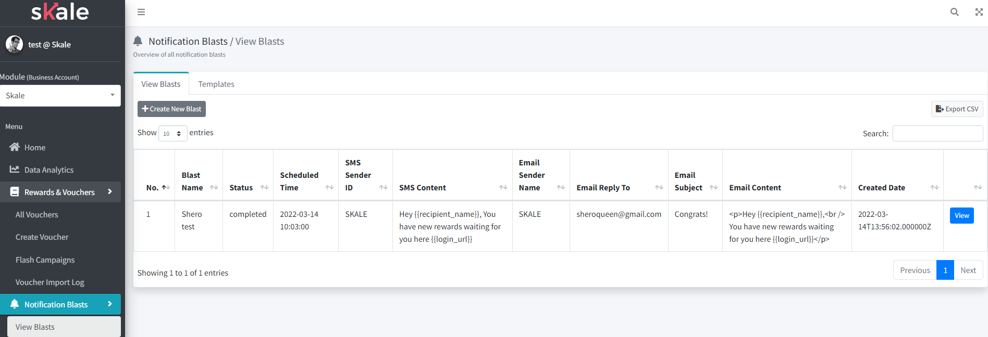
Trigger Customer Re-engagement Blasts easily
*Dummy data set for confidentiality purposes
Create Re-engagement Blasts easily
Personalize every engagement
33

Slide 37
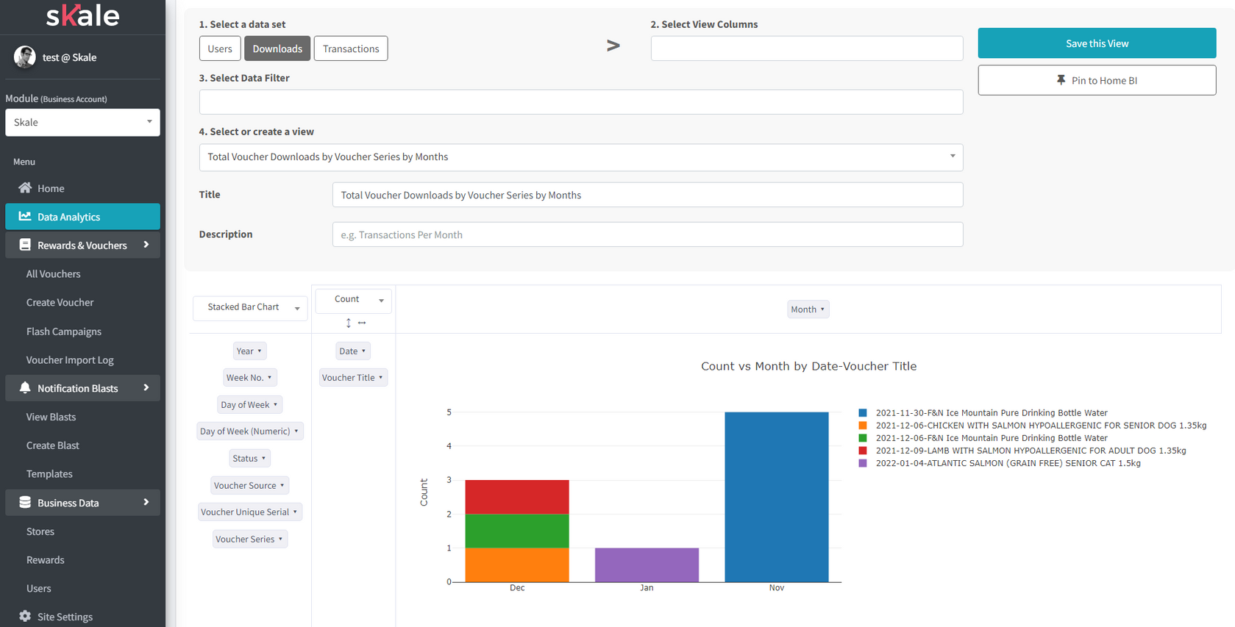
SKALE’s Analytics Platform is as modular and robust as Excel,
Ready For Use by marketers, data analysts and more from Day 1 without any training
Any type of chart you need in a Dropdown box
Access any data set you need
34

Slide 38
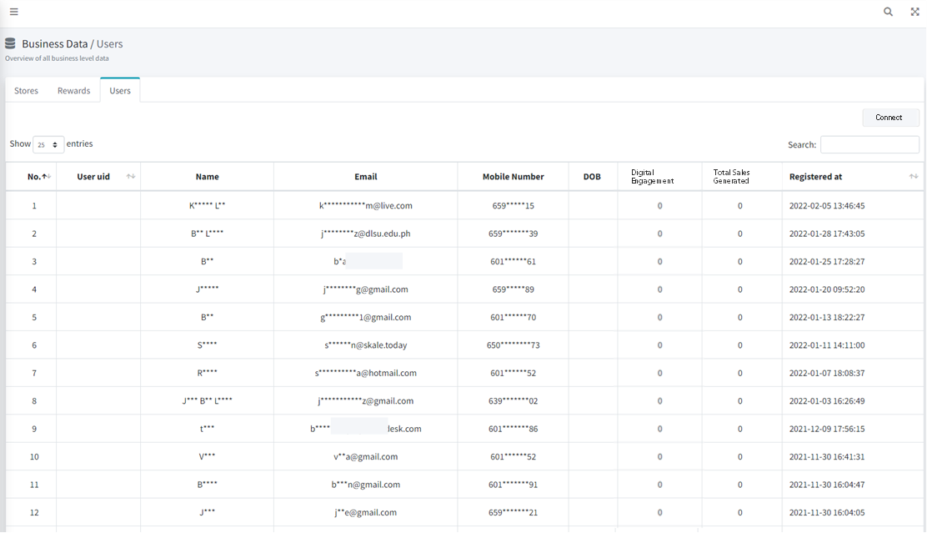
Connect all your Customer Data with your Existing Marketing Infrastructure
*Dummy data set for confidentiality purposes
1
CRM
All your offline Customer Data in 1 place
2
Customer Data Platform
Connect your Offline Customer Data to your systems
Facebook / Google Ads
Score your customer’s lifetime value
(Digital / Store Engagement and Total Sales)
3
Ecommerce Platform
4
35

Slide 39
GAMIFICATION FAQS
Can participants still redeem rewards in the rewards marketplace after the campaign ends? | Yes. To set the validity of rewards, you can change the date in the Rewards Marketplace Validity section on the campaign page.
What are the design elements I can edit on the game? | You can change the masthead, background image, logo, font color, button color, and footer.
How can offline engagement be tracked? | You can scan a QR code, enter a 6-digit pin, or do both. If you chose Scan QR code, you'll need to create QR codes on the platform to use in offline sales channels. The 'Enter 6 Digit Pin' method requires you to generate the pin using the platform and then distribute it to employees who will manually enter the pin.
Can the 'social media follow', 'app install', 'snap a photo', and 'upload a receipt' challenges be automatically verified? | Yes, you can use the Auto Approve feature to instantly verify and award points for uploaded images. This feature, however, does not automatically assess the image's quality or validity. You can manually approve the images or work with SKALE's experts to develop the backend capability to ensure that each entry is qualified.
Can I upload videos or GIFs on the challenge images? | No. Currently, you can only upload PNG or JPG formats of images on the challenge images.
Can I give out rewards instead of points and chances for challenges? | No. You can only give out points and chances. The user can claim the reward by using points or chances in the rewards marketplace page.
Do I need to download an app? | No. SKALE is a web-based platform.
​​What kind of packages do you offer? | Standard and advanced
What games are in the Standard Package? | Standard Package Games: Spin & Win, Digital Scratch Card, and Digital Quiz
What games are in the advanced package? | Games in Standard Package plus Digital Stamp Card, Augmented Reality / Metaverse and Customized Gamification
What is the difference between the standard and advanced package? | The standard package is customized by the agency themselves and has fewer games.
36

Slide 40
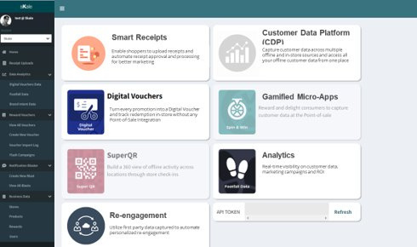
Experience our Marketing Platform today!
BOOK A DEMO
or email us at hello@skale.today

