Slide 1
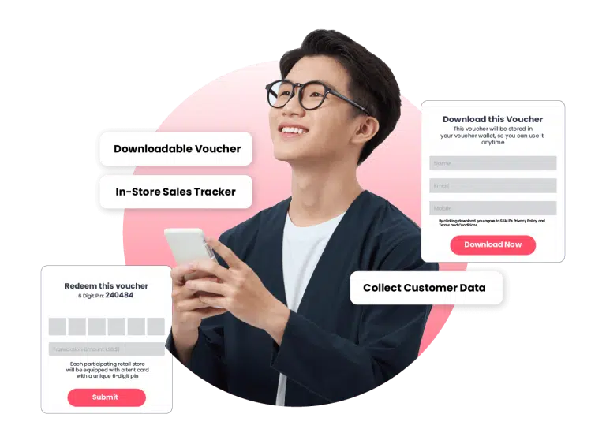
Digital Voucher Guide for Agency Owners
INTRODUCTION GUIDE

Slide 2
WHAT'S INSIDE
Why Partner with SKALE?
SKALE’s Digital Vouchering Solution
User Journey Experience
Agency Partnership Tiers
Our Agency Onboarding Journey
How to Activate SKALE’s Solutions
Try SKALE’s Demo Now
Tutorials
FAQs
Contact Us
1
2
4
6
7
8
9
10
11
12

Slide 3
Track In-Store Conversions and Demonstrate ROI to Clients
Why Partner with SKALE?
New Revenue Share Opportunity
Resell SKALE’s Technology
(20% - 50% Mark Up on Discounted Pricing)
Tech Fully Managed by SKALE)
Opportunity to Increase Client Budgets and Total Size of Client Accounts
SKALE’s Agency Partners are generating 6-digit revenue (USD) from re-selling SKALE’s Technology Solutions
Go beyond Tactical Campaigns,
Help Clients Capture Customer Data
Free Partnership Program
No Frills, No Minimum Targets
Full Access to Agency Resources
1

Slide 4
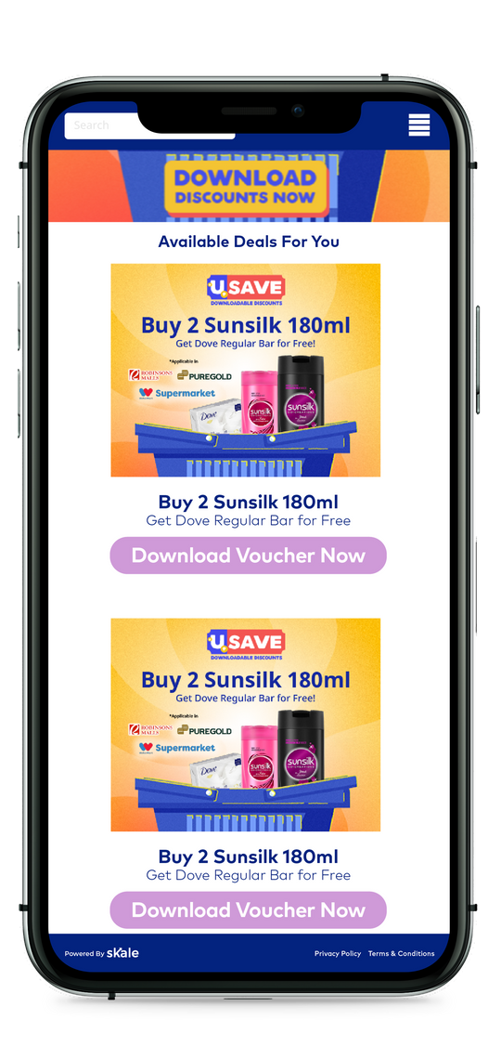
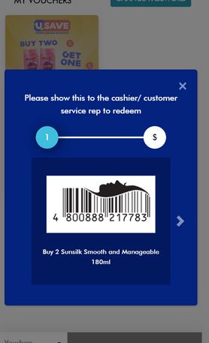
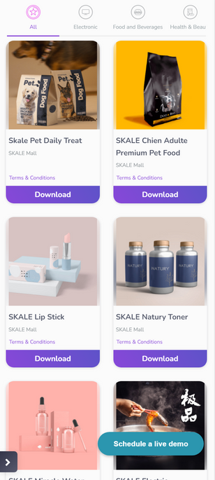
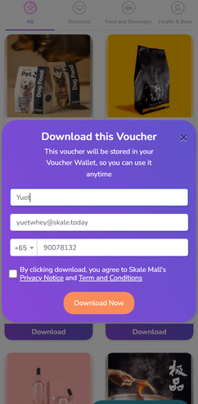
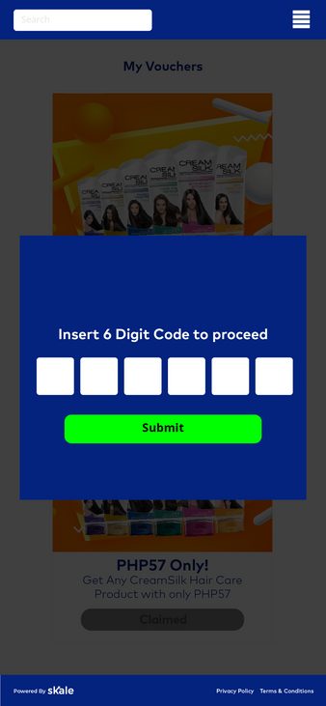
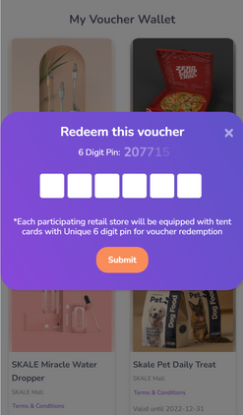
SKALE’s Digital Vouchering Solution
(Track every Promotion redemption with no POS integration)
13 May 2021 2.39 pm
Hi Jane, head down to Mall X this weekend to enjoy Complimentary Gift Wrapping at our Atrium
Here’s a Digital Voucher that we think you may enjoy too
Name
Email
Mobile
Turn every Promotion into App-less Digital Vouchers that
Captures First-Party Data
Useable across thousands of outlets
Capture Customer Data
& Interaction across
multi-touchpoint
In-store and online
Real-Time ROI Tracking
Without POS integration
Track Voucher Usage with
Works with 99% of all POS systems
Automated
Re-engagement
Reminder to Use Voucher
Drive Repeated Visits
Upsell / Cross-Sell
2

Slide 5
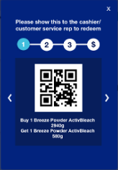
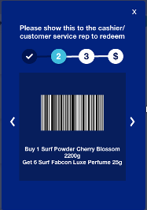
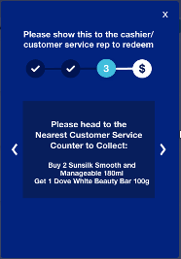
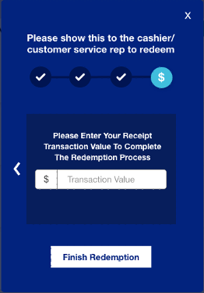
SKALE’s Digital Vouchering Solution
(Track every Promotion redemption with no POS integration)
QR Code
Barcode
In-Store
Instructions
Upload Receipt or
Input Transaction Data
3
GrowthDesk
‹#›

Slide 6
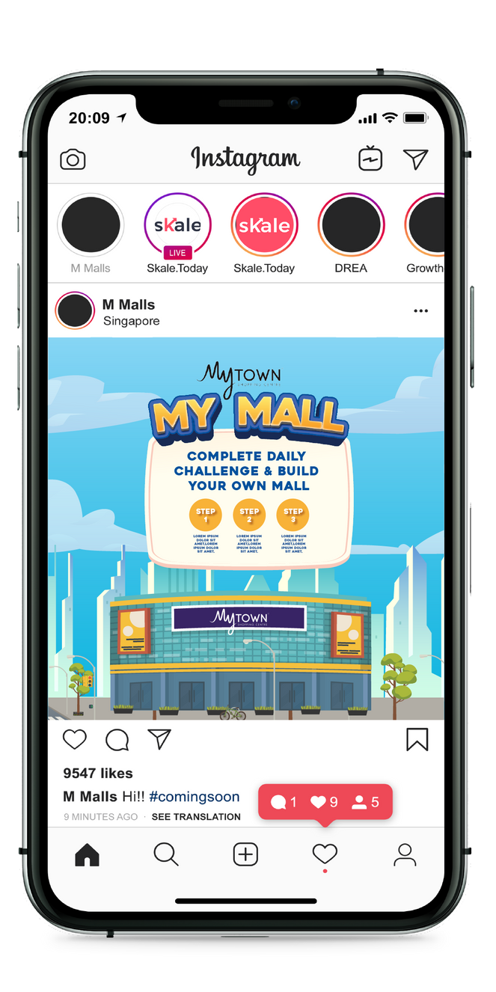
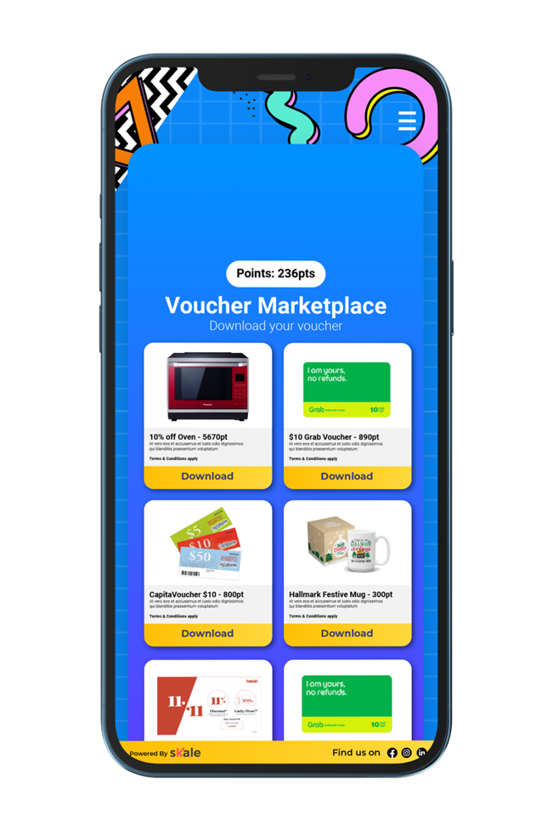
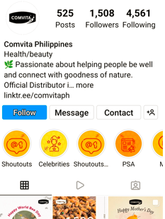
USER JOURNEY – DIGITAL VOUCHER
User fill in details on once, subsequent downloads will require no additional action
Step 2
The user is directed to Digital Voucher Homepage. The user downloads desired voucher
Step 3
The user is directed to a registration page to input their name, email, and mobile number.
(Collection of Customer Data for the mall)
Step 1
The user sees an ad on a relevant social channel
4

Slide 7
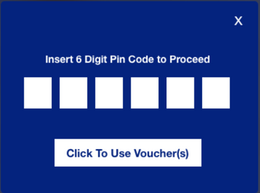
USER JOURNEY – DIGITAL VOUCHER
(Optional Step)
SKALE can automatically display barcode, QR code or pin code that is compatible with Store POS
All data are tracked real time and are viewed through SKALE’s Admin Dashboard
Step 4
User redeem voucher at participating outlet. Shopper input 6-digit pin that is placed on cashier to use voucher.
Step 5 (OPTIONAL)
A Promotional Method will be generated in the form of a Barcode, QR, and Unique Pin to apply for the promotion
Step 6
User input the transaction amount as a final step.
5

Slide 8
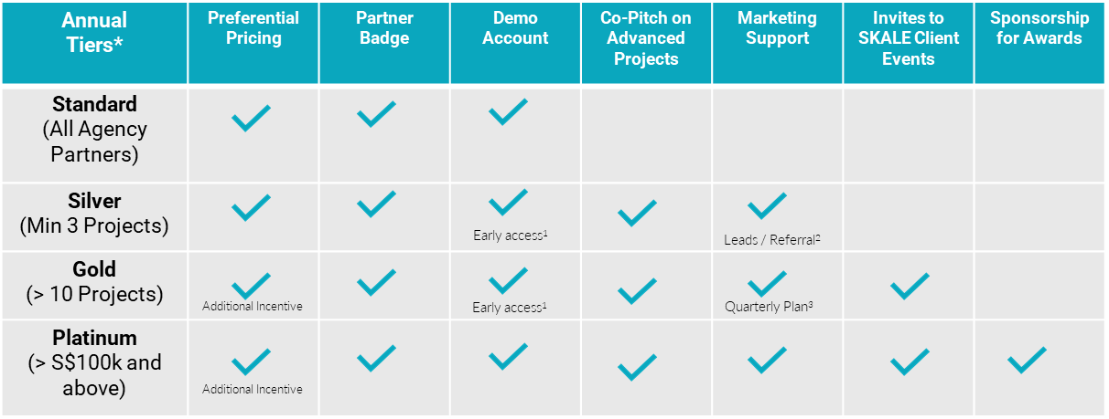
AGENCY PARTNERSHIP TIERS
*Annual tiers reset at end of each calendar year
Early access to new product roll-outs for Standard and Advanced Modules
SKALE reserves full discretion on its marketing and lead generation plans to generate leads for its agency partners
SKALE shall align with its agency partner on its quarterly marketing budget and support
6

Slide 9
OUR AGENCY ONBOARDING JOURNEY
Introduction to SKALE
Signing of Standard Agency Partnership Agreement
Provide Access to
Agency Portal
Demo(s)
Ready to use Slides
Rate Card
Agreement
FAQ
Trainings for
Sales Team / Account Managers / Digital Marketing
C-Suite
Introduction to
Digital Marketers / Account Managers /
(Optional)
Proof-of-Concept
With Agency’s Client
7

Slide 10
HOW TO ACTIVATE SKALE’S SOLUTIONS
Standard
Agency Creates
Project via
Dashboard
Agency Requests SKALE Quotation From Partner Manager
& Signs Off
SKALE
Activates Project Created by Agency
Co-Pitch with Agency
(SKALE as Technology Partner)
Advanced
SKALE Reviews Requirements from Agency
Does Agency Require Deck from SKALE?
Yes
SKALE provides Quotation and Est. Timeline
No
8

Slide 11
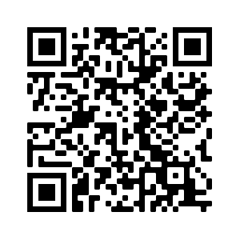
27X
ROAS
Try SKALE’s Demo Now
SKALE Digital Vouchers
Captures Customer Data Real Time
Utilize Vouchers Across Thousands of Retail Partner Outlets
Compatible with 99% of POS Systems
9
GrowthDesk
‹#›

Slide 12
HOW TO CREATE A DIGITAL VOUCHER USING SKALE
HOW TO TRACK AND REDEEM DIGITAL VOUCHERS
10

Slide 13
DIGITAL VOUCHERS FAQS
Is there a limit to the vouchers I can create? | No, you can create unlimited vouchers.
Where can I publish the vouchers? | Your vouchers will appear on the rewards marketplace. You can publish and distribute them via social media, email, through a separate app, your website and via SMS.
What are the kinds of customer data I can collect with digital vouchers? | Upon registration, you can collect the user's name, email, and mobile number.
How can the user redeem the voucher? | If you've selected an in-store voucher, the user can redeem it by scanning a bar code or QR code, presenting a unique promo code or SMS, or manually entering the 6-digit pin code inside the store. If you've chosen an e-commerce voucher, the user can redeem it by entering a special promo code.
Can I limit the number of redemptions for each voucher download? | Yes. For each voucher download, you can specify the maximum number of redemptions within a given time frame.
How many SMS message/reminder can I send? | Only 1 for each user daily.
Where can I add outlets and generate QR codes or 6-digit pin on each outlet? | In the 'Stores' section under Business Data
Can I export the details of the people who downloaded the vouchers? | You can export the data but not the users' full names, email addresses, or phone numbers. You can obtain this information from SKALE representatives.
How will I know how well my vouchers are performing? | You can view your voucher's performance data, such as total downloads, total redemptions, total transaction value, and more.
11

Slide 14
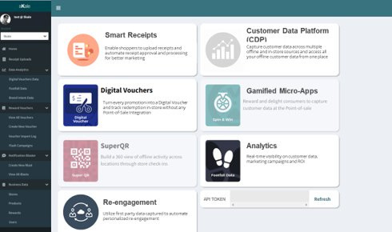
Experience our Marketing Platform today!
BOOK A DEMO
or email us at hello@skale.today

