Slide 1
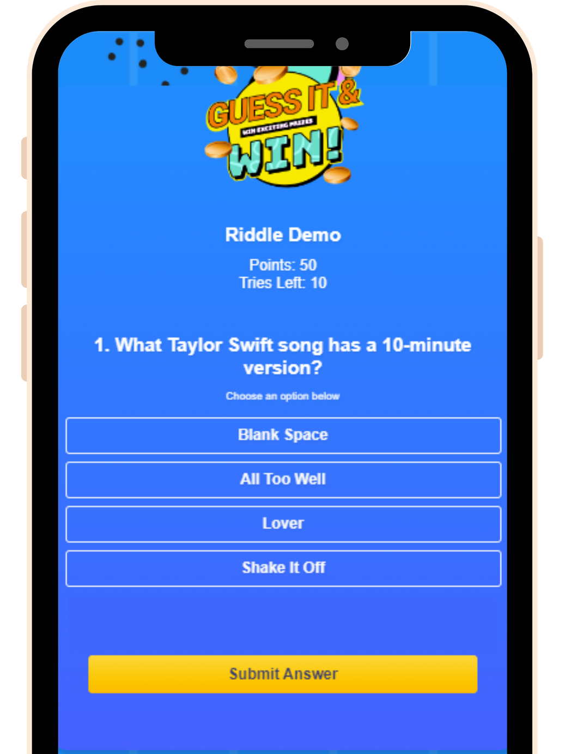
Daily Riddles/ Quizzes
INTRODUCTION GUIDE

Slide 2
WHAT'S INSIDE
Why Partner with SKALE?
User Journey Experience
Agency Partnership Tiers
Our Agency Onboarding Journey
How to Activate SKALE’s Solutions
Challenges
Tutorial
FAQs
Contact Us
1
2
4
5
6
7
8
9
11

Slide 3
Track In-Store Conversions and Demonstrate ROI to Clients
Why Partner with SKALE?
New Revenue Share Opportunity
Resell SKALE’s Technology
(20% - 50% Mark Up on Discounted Pricing)
Tech Fully Managed by SKALE)
Opportunity to Increase Client Budgets and Total Size of Client Accounts
SKALE’s Agency Partners are generating 6-digit revenue (USD) from re-selling SKALE’s Technology Solutions
Go beyond Tactical Campaigns,
Help Clients Capture Customer Data
Free Partnership Program
No Frills, No Minimum Targets
Full Access to Agency Resources
1

Slide 4
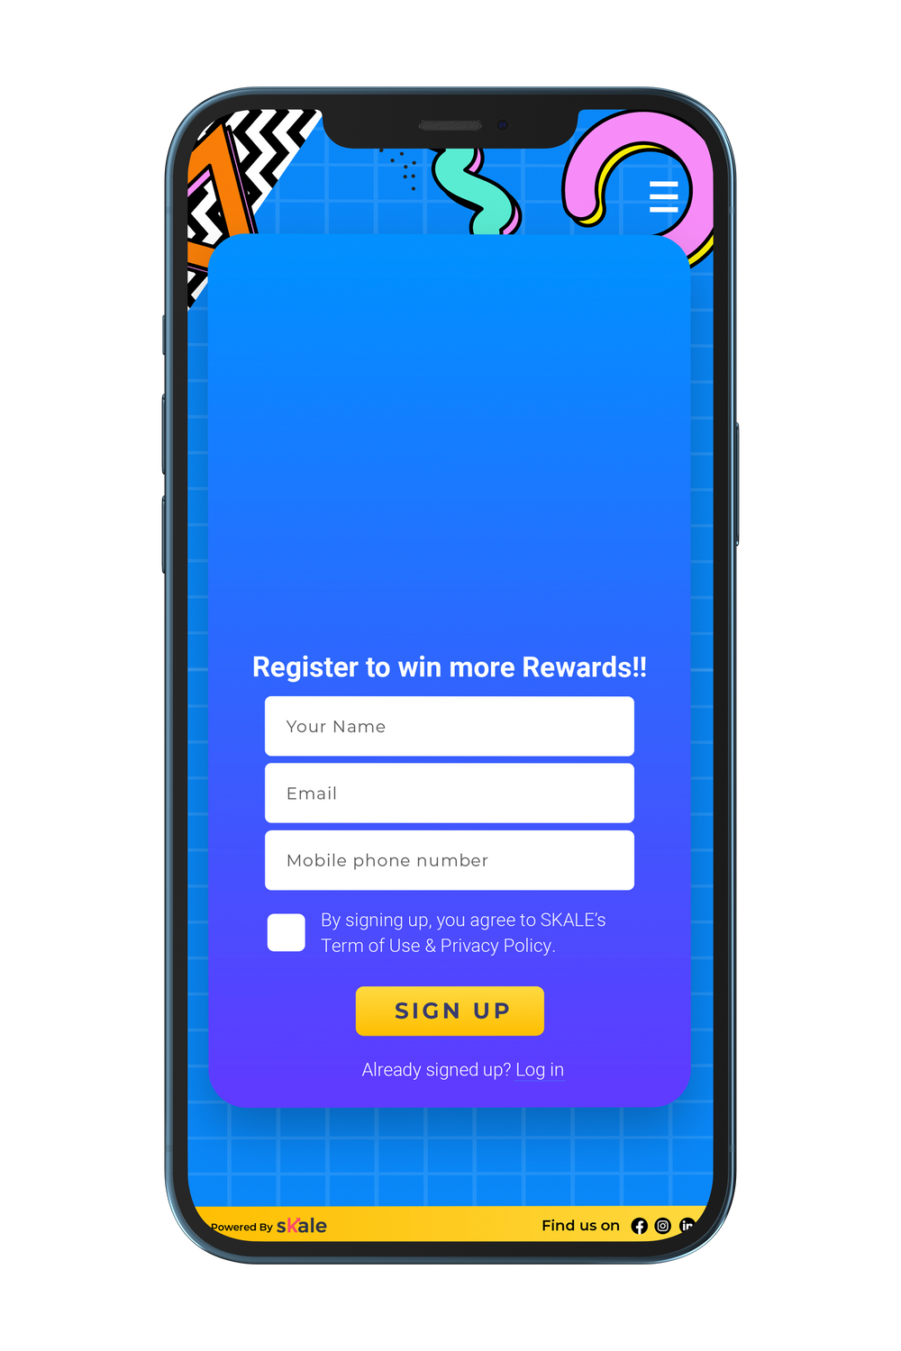
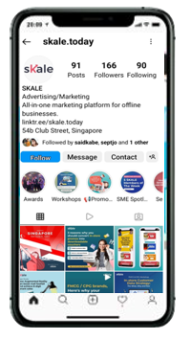
USER JOURNEY – DAILY RIDDLE
Shoppers are driven to the platform via Social Media Ads, EDM, or to the organic follower base
Capture First Party Customer Data
When Shoppers register
Shopper is directed to Daily Riddle gamification module
2

Slide 5
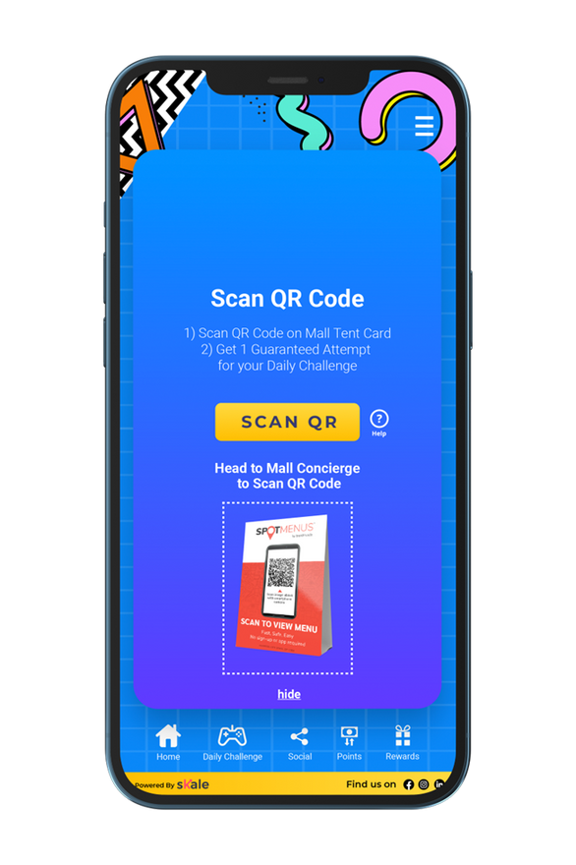
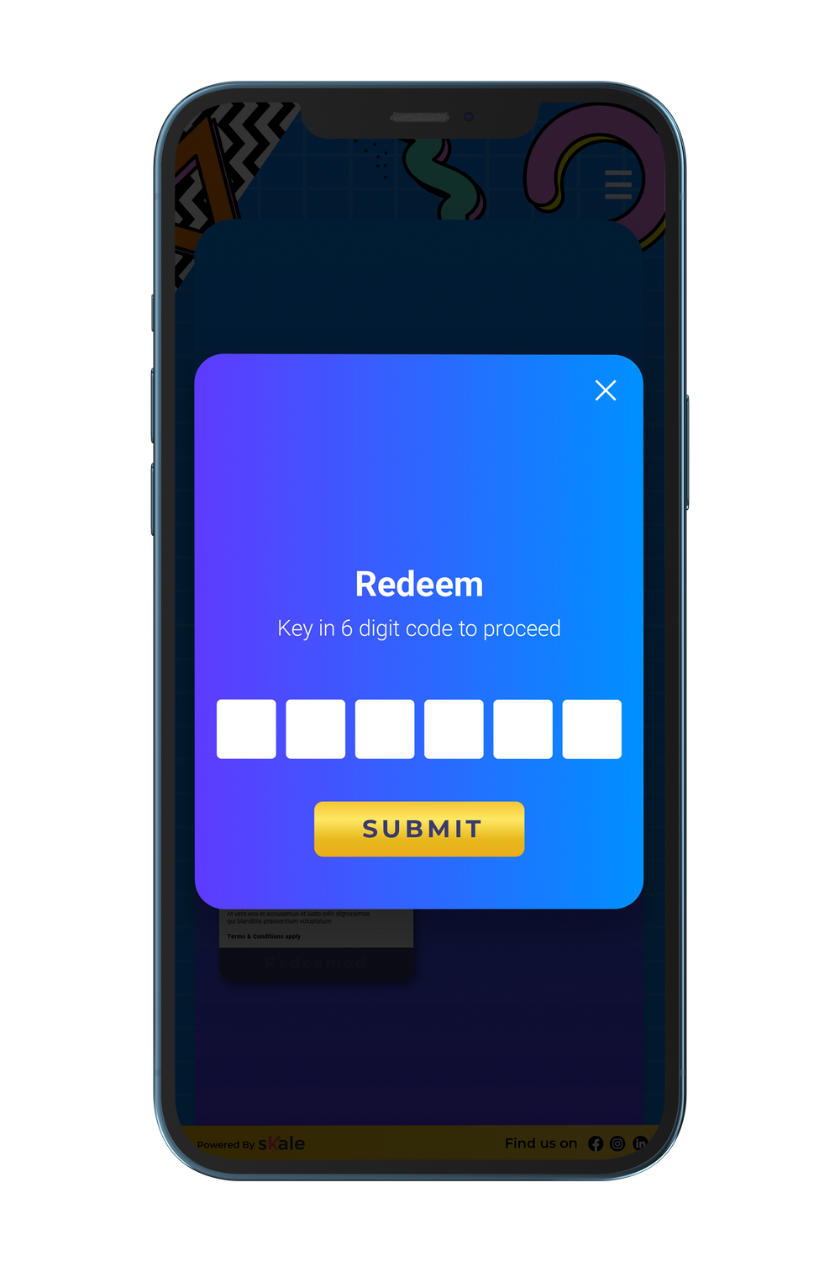
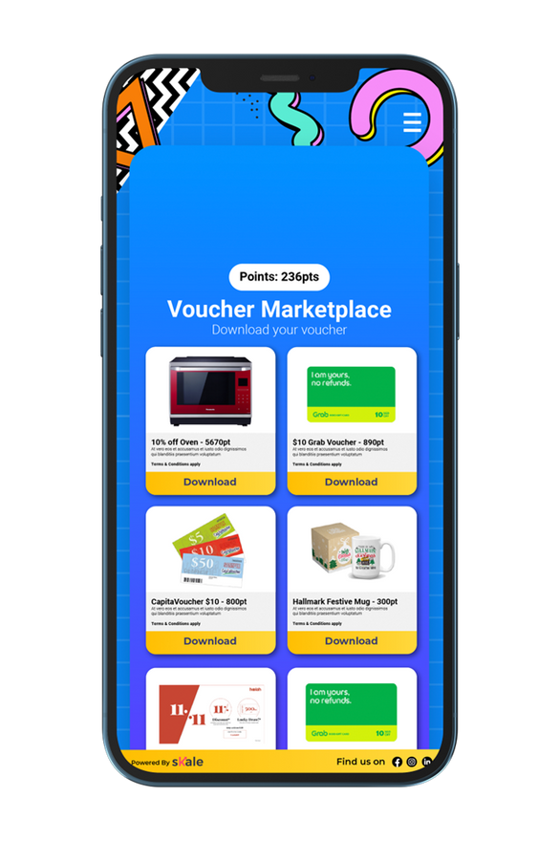
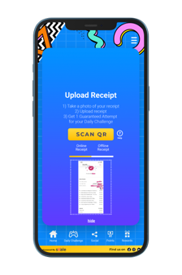
USER JOURNEY – DAILY RIDDLE
Shopper is rewarded with
Points for each attempt.
Upload Receipt
User prompted Scan QR or upload receipt upon making a purchase to unlock additional points
SKALE has ability to customize Point provisioning / number of attempts provisioned based on actions taken
Scan QR
Refer Friend
Follow Social Media
Upload photo
Shopper can redeem their rewards through the rewards marketplace
3

Slide 6
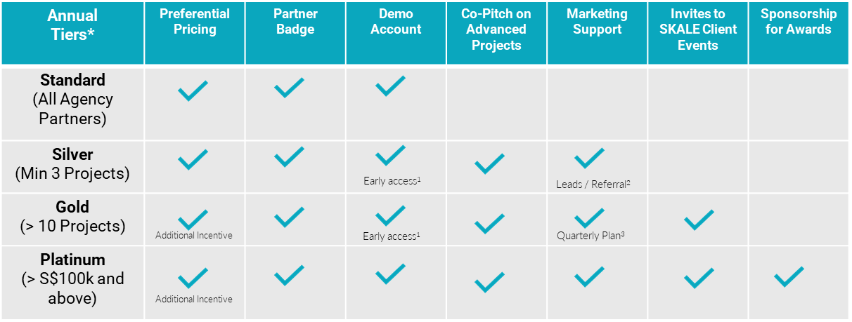
AGENCY PARTNERSHIP TIERS
*Annual tiers reset at end of each calendar year
Early access to new product roll-outs for Standard and Advanced Modules
SKALE reserves full discretion on its marketing and lead generation plans to generate leads for its agency partners
SKALE shall align with its agency partner on its quarterly marketing budget and support
4

Slide 7
OUR AGENCY ONBOARDING JOURNEY
Introduction to SKALE
Signing of Standard Agency Partnership Agreement
Provide Access to
Agency Portal
Demo(s)
Ready to use Slides
Rate Card
Agreement
FAQ
Trainings for
Sales Team / Account Managers / Digital Marketing
C-Suite
Introduction to
Digital Marketers / Account Managers /
(Optional)
Proof-of-Concept
With Agency’s Client
5

Slide 8
HOW TO ACTIVATE SKALE’S SOLUTIONS
Agency Creates
Project via
Dashboard
Agency Requests SKALE Quotation From Partner Manager
& Signs Off
SKALE
Activates Project Created by Agency
Standard
Co-Pitch with Agency
(SKALE as Technology Partner)
SKALE Reviews Requirements from Agency
Does Agency Require Deck from SKALE?
Yes
Advanced
SKALE provides Quotation and Est. Timeline
No
6

Slide 9
CHALLENGES
Upload a Receipt
Follow a social media page
Upload a photo
You can either manually approve customer receipts on the platform or utilize SKALE's smart receipts platform to automatically verify receipt uploads. Rewards can be personalized based on receipt data.
After users follow your Instagram or Facebook pages, you can request that they upload a screenshot of your page as proof that they completed the challenge.
You can ask users to upload a photo of your product, a selfie from your event, or any other image that demonstrates they've completed the platform challenge you've set.
Scan a QR code
Install an app
Log In
QR codes can be generated by our platform for your stores, product packaging, or offline activations.
SKALE's games automatically scan QR codes and award points or chances to players in real-time.
You can start the game as soon as users open the app. Alternatively, you can ask them to upload a screenshot of the app on their phones before awarding points or chances.
If you've enabled the daily check-in, you'll be able to award points or chances each time a user logs in or launches the game.
7

Slide 10
HOW TO CREATE A DAILY RIDDLE
8

Slide 11
DIGITAL QUIZ/ DAILY RIDDLES FAQS
Is there a limit to the number of questions I can ask? | None.
Do I always need to set an order of questions? | No. You can randomize the order of questions across all your users.
Is there a limit to the number of answers I can provide for each question? | Yes. You can create 2-5 options for each question.
Are there any other quiz types besides multiple choice? | No. Currently, SKALE's riddles only support the multiple-choice format.
Can I use formats other than text in the options? | No.
Can participants still redeem rewards in the rewards marketplace after the campaign ends? | Yes. To set the validity of rewards, you can change the date in the Rewards Marketplace Validity section on the campaign page.
What are the design elements I can edit on the game? | You can change the masthead, background image, logo, font color, button color, and footer.
How can offline engagement be tracked? | You can scan a QR code, enter a 6-digit pin, or do both. If you chose the Scan QR code, you'll need to create QR codes on the platform to use in offline sales channels. The 'Enter 6 Digit Pin' method requires you to generate the pin using the platform and then distribute it to employees who will manually enter the pin.
9

Slide 12
DIGITAL QUIZ/ DAILY RIDDLES FAQS
Can the 'social media follow', 'app install', 'snap a photo', and 'upload a receipt' challenges be automatically verified? | Yes, you can use the Auto Approve feature to instantly verify and award points for uploaded images.
Can I upload videos or GIFs on the challenge images? | No. Currently, you can only upload PNG or JPG formats of images on the challenge images.
Can I give out rewards instead of points and chances for challenges? | No. You can only give out points and chances. The user can claim the reward by using points or chances in the rewards marketplace page.
Do I need to download an app? | No. SKALE is a web-based platform.
​​What kind of packages do you offer? | Standard and advanced
What games are in the Standard Package? | Standard Package Games: Spin & Win, Digital Scratch Card, and Digital Quiz
What games are in the advanced package? | Games in Standard Package plus Digital Stamp Card, Augmented Reality / Metaverse and Customized Gamification
What is the difference between the standard and advanced package? | The standard package is customized by the agency themselves and has fewer games.

Slide 13
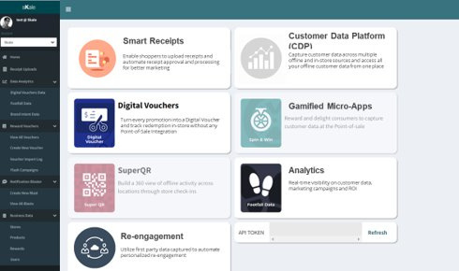
Experience our Marketing Platform today!
BOOK A DEMO
or email us at hello@skale.today

