Slide 1
DATA ANALYTICS
INTRODUCTION GUIDE

Slide 2
WHAT'S INSIDE
Why Partner with SKALE?
Agency Partnership Tiers
Our Agency Onboarding Journey
How to Activate SKALE’s Solutions
Benefits of SKALE’s Data Analytics platform
FAQs & Tutorial
Definition of Terms
Contact Us
1
3
4
5
6
7
8
10

Slide 3
Track In-Store Conversions and Demonstrate ROI to Clients
Why Partner with SKALE?
New Revenue Share Opportunity
Resell SKALE’s Technology
(20% - 50% Mark Up on Discounted Pricing)
Tech Fully Managed by SKALE)
Opportunity to Increase Client Budgets and Total Size of Client Accounts
SKALE’s Agency Partners are generating 6-digit revenue (USD) from re-selling SKALE’s Technology Solutions
Go beyond Tactical Campaigns,
Help Clients Capture Customer Data
Free Partnership Program
No Frills, No Minimum Targets
Full Access to Agency Resources
1

Slide 4
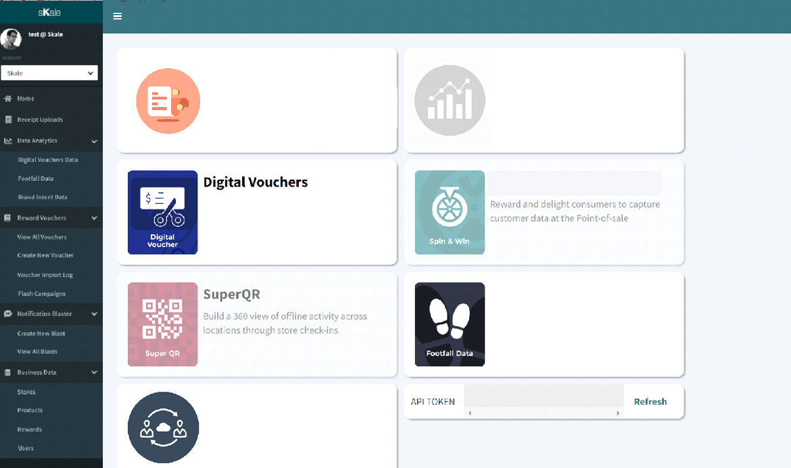
One Fully Integrated Platform for FMCG / CPG Businesses
Drive In-Store Sales to Retail Partner, Capture First Party Customer Data, Go Direct-to-Consumer
1
5
Capture Shopper
Receipt & First Party
Customer Data
Reward Shoppers for every Receipt
All Your Offline
Customer Data in 1 Place
First Party Data (Name, Email, Mobile) and
Transaction Data
1
5
2
2
6
Drive & Track In-Store
Purchases with Digital Vouchers
99% Compatible with all POS
6
Deploy Gamified Micro-Apps / Whatsapp Chat anytime
Marketing Campaigns that Drives Sales and Customer Data Capture
3
7
3
4
Track Unique QR Code
Scans
Digital Engagement, Redemption
or In-Store Check In
7
Analytics
Leverage on Customer, Shopper and Marketing Data for future marketing campaigns
4
Automate Smart
SMS / Email Re-engagement
Up-sell / Cross-Sell to Every Shopper
Convert Prospects into Shoppers
2

Slide 5
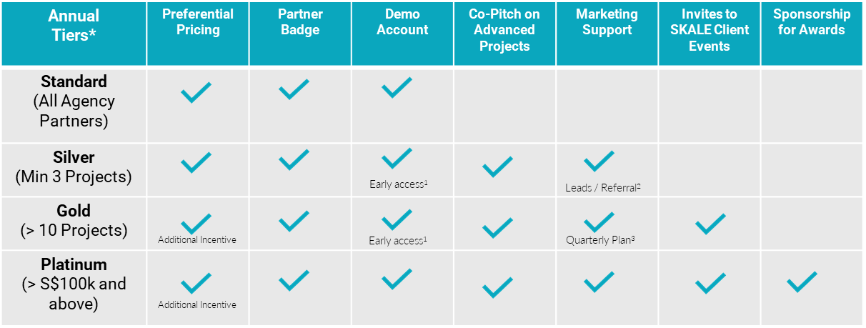
AGENCY PARTNERSHIP TIERS
*Annual tiers reset at end of each calendar year
Early access to new product roll-outs for Standard and Advanced Modules
SKALE reserves full discretion on its marketing and lead generation plans to generate leads for its agency partners
SKALE shall align with its agency partner on its quarterly marketing budget and support
3

Slide 6
OUR AGENCY ONBOARDING JOURNEY
Introduction to SKALE
Signing of Standard Agency Partnership Agreement
Provide Access to
Agency Portal
Demo(s)
Ready to use Slides
Rate Card
Agreement
FAQ
Trainings for
Sales Team / Account Managers / Digital Marketing
C-Suite
Introduction to
Digital Marketers / Account Managers /
(Optional)
Proof-of-Concept
With Agency’s Client
4

Slide 7
HOW TO ACTIVATE SKALE’S SOLUTIONS
Standard
Agency Creates
Project via
Dashboard
Agency Requests SKALE Quotation From Partner Manager
& Signs Off
SKALE
Activates Project Created by Agency
Co-Pitch with Agency
(SKALE as Technology Partner)
Advanced
SKALE Reviews Requirements from Agency
Does Agency Require Deck from SKALE?
Yes
SKALE provides Quotation and Est. Timeline
No
5

Slide 8
BENEFITS OF SKALE’S DATA ANALYTICS PLATFORM
POWERFUL ORGANIZATION
PERFORMANCE AND REVENUE ATTRIBUTION
Choose the main data set, narrow it down by data filters based on your report criteria, and navigate data points on rows and columns to get a comprehensive report on your chosen data set.
You can save views for future use and create visual representations of your report to share with others in your organization.
Our dashboard uncovers the user’s campaign source, lifetime value, and actions taken in our platform, or on external channels such as your ecommerce marketplaces or physical stores.
You can also measure the incentives (points, chances, and rewards) delivered and optimize campaigns to yield higher returns from users.
SMS AND EMAIL AUTOMATION
ROBUST CUSTOMER SEGMENT CREATION
You can use our platform to create SMS and email campaigns, personalize various fields, and send them to specific customer segments.
Our platform is an effective tool for building long-lasting relationships with all types of customers, whether you want to reach first-time customers, active engagers, or brand advocates.
Our segments are a way to filter, analyze, and act upon data and insights generated in our platform.
You can build customer segments based on customer details, purchase data, conversions both online and offline, and lifetime value.
6

Slide 9
FAQS
TUTORIAL
Do I need to fill out all fields (data set, columns, and data filter) in order to view the data? | No. Simply select the data set you want to view. The remaining fields can be used to narrow down the data points that will appear in the table below.
Can I just use the generic tab to get all the information I need? | You may use the generic tab to uncover relevant data on user acquisition and engagement.
How can I assess campaign performance in relation to my objectives? | You can focus on a specific goal by going to the events tab. You can see how your user actions are translating to relevant KPIs in this section.
How can I tell if the games are producing conversions? | Navigate to the challenges tab to see data on your customers' online and in-store activities.
What if I'd like to focus on a specific module? | You can select a product-specific tab (vouchers, scratch card, etc.) to view data related to that product only.
Can I export the data? | Yes. You cannot, however, obtain your users' full names, email addresses, or mobile phone numbers. This data can be requested from SKALE's representatives
7

Slide 10
DEFINITION OF TERMS
General | This section contains high level data on your customer. You’ll see the user demographics, campaign source, engagement metrics, incentives delivered, and other crucial data points related to the user.
Event | This shows the actions taken by the user within the platform. You can filter by goals, reward name, games, and more.
Vouchers | This section uncovers data on your digital vouchers. It shows real-time metrics on your voucher campaign performance such as downloads, in-store redemptions, user source, and more.
Spin Wheel | This shows data specific to the Spin & Win game. See the points or chances delivered per user, the number of rewards delivered, and more.
Challenges | Know what challenges are users completing as they play the games you’ve launched. You’ll see data on specific challenges such as the overall conversion breakdown, chances used, and more.
Data sets | The main data point that you’d like to focus on. Data sets very per section.
View Columns | You can select specific data categories that matter the most for the report. Options selected would appear in the table section below.
Data filter | You can further filter down by selecting specific options under the data categories selected.
Select a view | You can select a saved view from your past reports.
Create a view | Generate the data categories in the table below.
Table | You can drag and drop data categories in the column and row sections to generate a data breakdown for each category. You can select the type of data that you’d like to generate for data point: count, sum, average, median, etc.
8

Slide 11
User email | The email provided by the user upon registration
Referred users | The users referred by past players in the challenges
Total session duration | The overall time each user had spent on the platform
UTM source | Where the user came from when he/she registered
UTM campaign | The campaign name that led to the user’s conversions
Source of points/chances | The platform module that delivered the points/chances to the user.
Approval date | The dates that the images sent by the user have been approved the platform’s admin
Mobile verified | The total number of mobile numbers that have been verified by the system
In-store conversions | Refer to actions done offline such as receipt uploads or in-store purchases.
QR scans | The number of times the QR codes generated by the platform have been scanned (online and offline)
Reward name | Breakdown of total rewards delivered categorized by the name provided by the admin
Challenge name | Breakdown of challenges completed categorized by type (receipt uploads, app installs, etc.)
Game type | The game played by the users in the platform
Voucher title | The title of the voucher provided by the admin upon voucher creation
Voucher series status | Shows the total number of active, inactive, and expired vouchers
Total transaction amount | The total transaction amount captured by the receipt sent by the user
No. of unique voucher downloaded | Shows how many users downloaded/redeemed the promotion
No. of vouchers downloaded/redeemed | Shows the total number of downloads/redemptions across all platforms
No. of transactions | Total number of purchases shared by the user through various methods (receipt uploads, QR code scans, order numbers, etc.)
Average transaction amount | Average spend of users based on their purchase data
Digital engagement | Pertains to online conversions such as website visits, social media follows, in-game actions, and more.
Voucher source | The channel where the user came from when he/she downloaded the voucher
Total downloads | Total number of voucher downloads across all platforms
Voucher series type | Shows tidal vouchers by type (in-store, online, physical item)
9

Slide 12
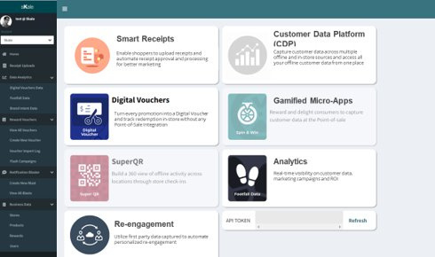
Experience our Marketing Platform today!
BOOK A DEMO
or email us at hello@skale.today

